Slide 1
A Primer on Quantile Regression for Epidemiologists
Aayush Khadka, Jilly Hebert, Anusha M. Vable
Department of Family and Community Medicine University of California San Francisco

Slide 2
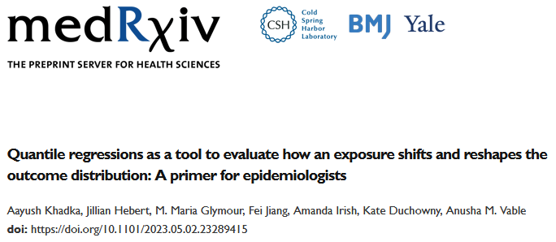


Slide 3
Funding and acknowledgements
Funding: National Institute on Aging (R01 AG069092, PI Vable).
Many thanks to:
VabLab team
Maria Glymour’s research team
Dr. Catherine Duarte
ChatGPT

Slide 4
Overall learning aims
Theory | Practice
What is quantile regression and why do we care about it? | How do we run quantile regression analyses in R?
How does quantile regression differ from mean regression? | How can we present quantile regression coefficients?
How do estimators targeted at quantiles of the conditional vs. unconditional outcome distributions differ from one another? | How can we visualize how distributions are affected by an exposure using quantile regression results?

Slide 5
Overall learning aims
Theory | Practice
What is quantile regression and why do we care about it? | How do we run quantile regression analyses in R?
How does quantile regression differ from mean regression? | How can we present quantile regression coefficients?
How do estimators targeted at quantiles of the conditional vs. unconditional outcome distributions differ from one another? | How can we visualize how distributions are affected by an exposure using quantile regression results?

Slide 6
Overall learning aims
Theory | Practice
What is quantile regression and why do we care about it? | How do we run quantile regression analyses in R?
How does quantile regression differ from mean regression? | How can we present quantile regression coefficients?
How do estimators targeted at quantiles of the conditional vs. unconditional outcome distributions differ from one another? | How can we visualize how distributions are affected by an exposure using quantile regression results?

Slide 7
Previewing our practical example
We will investigate the relationship between educational attainment and systolic blood pressure (SBP) in later-life
Education has a strong, inverse relationship with average SBP levels
There may be a non-linear relationship between later-life SBP and risk of coronary heart disease and stroke
Motivates the need to investigate if educational attainment affects the distribution of blood pressure

Slide 8
Previewing our practical example
We will use data from the US Health and Retirement Study
Nationally representative, multi-cohort, biennially conducted longitudinal study of non-institutionalized US adults 50+ years
Exposure: Self-reported total years of schooling (5-17 years)
Outcome: First recorded SBP (2006-2018)
Covariates:
Age (linear + quadratic)
Sex (Female/Male persons)
Race (Black/Latinx/White)
Southern birth (yes/no)
Mother’s education (5-17)
Father’s education (5-17)
SBP measurement year (2006-2018)

Slide 9
Teaching resources
Slide deck: theory discussion
: Key point
Handout: includes write-up on quantile regression + R code
GitHub: includes the R Markdown file for the handout, additional code for the figures, slide deck, and other resources
Link: https://github.com/JillianHebert/A-Primer-on-Quantile-Regression-for-Epidemiologists

Slide 10
Terminology we use interchangeably
Marginal and unconditional

Slide 11
Terminology we use interchangeably
Marginal and unconditional
Means and expectation

Slide 12
Terminology we use interchangeably
Marginal and unconditional
Means and expectation
Scale, spread, and variance

Slide 13
Terminology we use interchangeably
Marginal and unconditional
Means and expectation
Scale, spread, and variance
Epsilon and error

Slide 14
Terminology we use interchangeably
Marginal and unconditional | Tangerine and orange
Means and expectation
Scale, spread, and variance
Epsilon and error

Slide 15
Terminology we use interchangeably
Marginal and unconditional | Tangerine and orange
Means and expectation | Teal and green
Scale, spread, and variance
Epsilon and error

Slide 16
Terminology we use interchangeably
Marginal and unconditional | Tangerine and orange
Means and expectation | Teal and green
Scale, spread, and variance | Rose and red
Epsilon and error

Slide 17
Abbreviations
Abbreviation | Full form
CDF | Cumulative Distribution Function
CEF | Conditional Expectation Function
CQF | Conditional Quantile Function
CQR | Conditional Quantile Regression
DGP | Data Generating Process
IF | Influence function
OLS | Ordinary Least Squares
RIF | Recentered Influence Function
SBP | Systolic Blood Pressure
UQR | Unconditional Quantile Regression

Slide 18
Outline of the workshop
Importance of focusing on the entire outcome distribution (~12 mins)
Means and quantiles (~30 mins) 10-minute break
Linear regression + R code (~30 mins) 30-minute food break
Conditional quantile regression + R code (~45 mins) 10-minute break
Unconditional quantile regression + R code (~45 mins)
Compare and conclude (~15 mins)

Slide 19
Key takeaways from this workshop
Investigating how an exposure affects the entire outcome distribution, in particular the tails, is substantively important
Quantile regressions allow us to quantify the relationship of an exposure with the outcome distribution
Need to determine if we are interested in quantiles of the conditional or unconditional outcome distribution in advance
Separate estimators need to be used for quantiles of the conditional versus unconditional outcome distribution

Slide 20
A matter of life and distributions
i.e., a case for why we should focus on the entire outcome distribution

Slide 21
Learning aims
Why it’s important to think about the entire outcome distribution
When can mean models help us learn about how an exposure affects the entire outcome distribution?

Slide 22
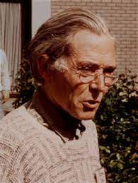
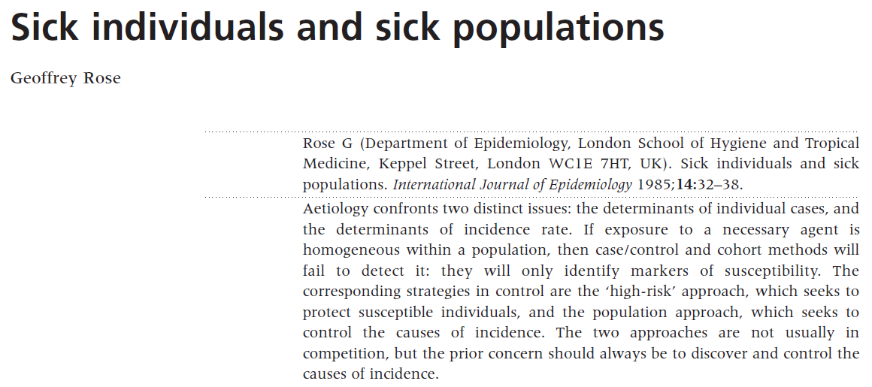
“Geoffrey Rose’s big idea”*
*The title of this slide comes from a Commentary written by A Hofman and JP Vandenbroucke (1992). Link
Notes:
Note: The title of this slide is also the title of a 1992 commentary on Rose’s work. Link: https://www.ncbi.nlm.nih.gov/pmc/articles/PMC1884728/pdf/bmj00105-0011.pdf

Slide 23
Determinants of cases vs. determinants of incidence
 | Determinants of cases | Determinants of incidence
Question of interest | Why did this patient get this disease at this time? | Why do some populations, but not others, have high rates of disease?

Slide 24
Determinants of cases vs. determinants of incidence
 | Determinants of cases | Determinants of incidence
Question of interest | Why did this patient get this disease at this time? | Why do some populations, but not others, have high rates of disease?
Approach to answering question of interest | Search for individual-level risk factors | Search for population-level determinants of disease distribution

Slide 25
Determinants of cases vs. determinants of incidence
 | Determinants of cases | Determinants of incidence
Question of interest | Why did this patient get this disease at this time? | Why do some populations, but not others, have high rates of disease?
Approach to answering question of interest | Search for individual-level risk factors | Search for population-level determinants of disease distribution
Implied approach for reducing disease burden | Target individuals at high risk of disease | Shift the distribution of the disease determinant in the population

Slide 26
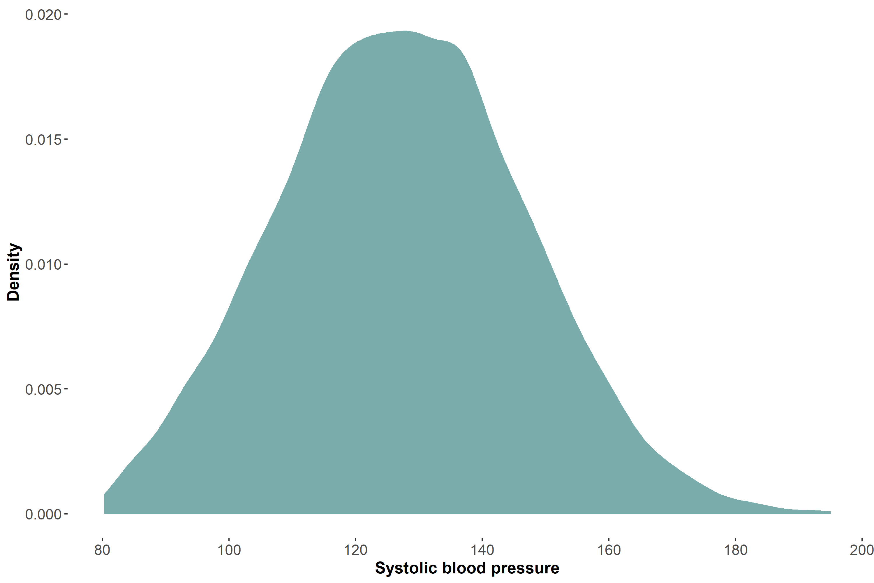
Illustrating Rose’s big idea

Slide 27
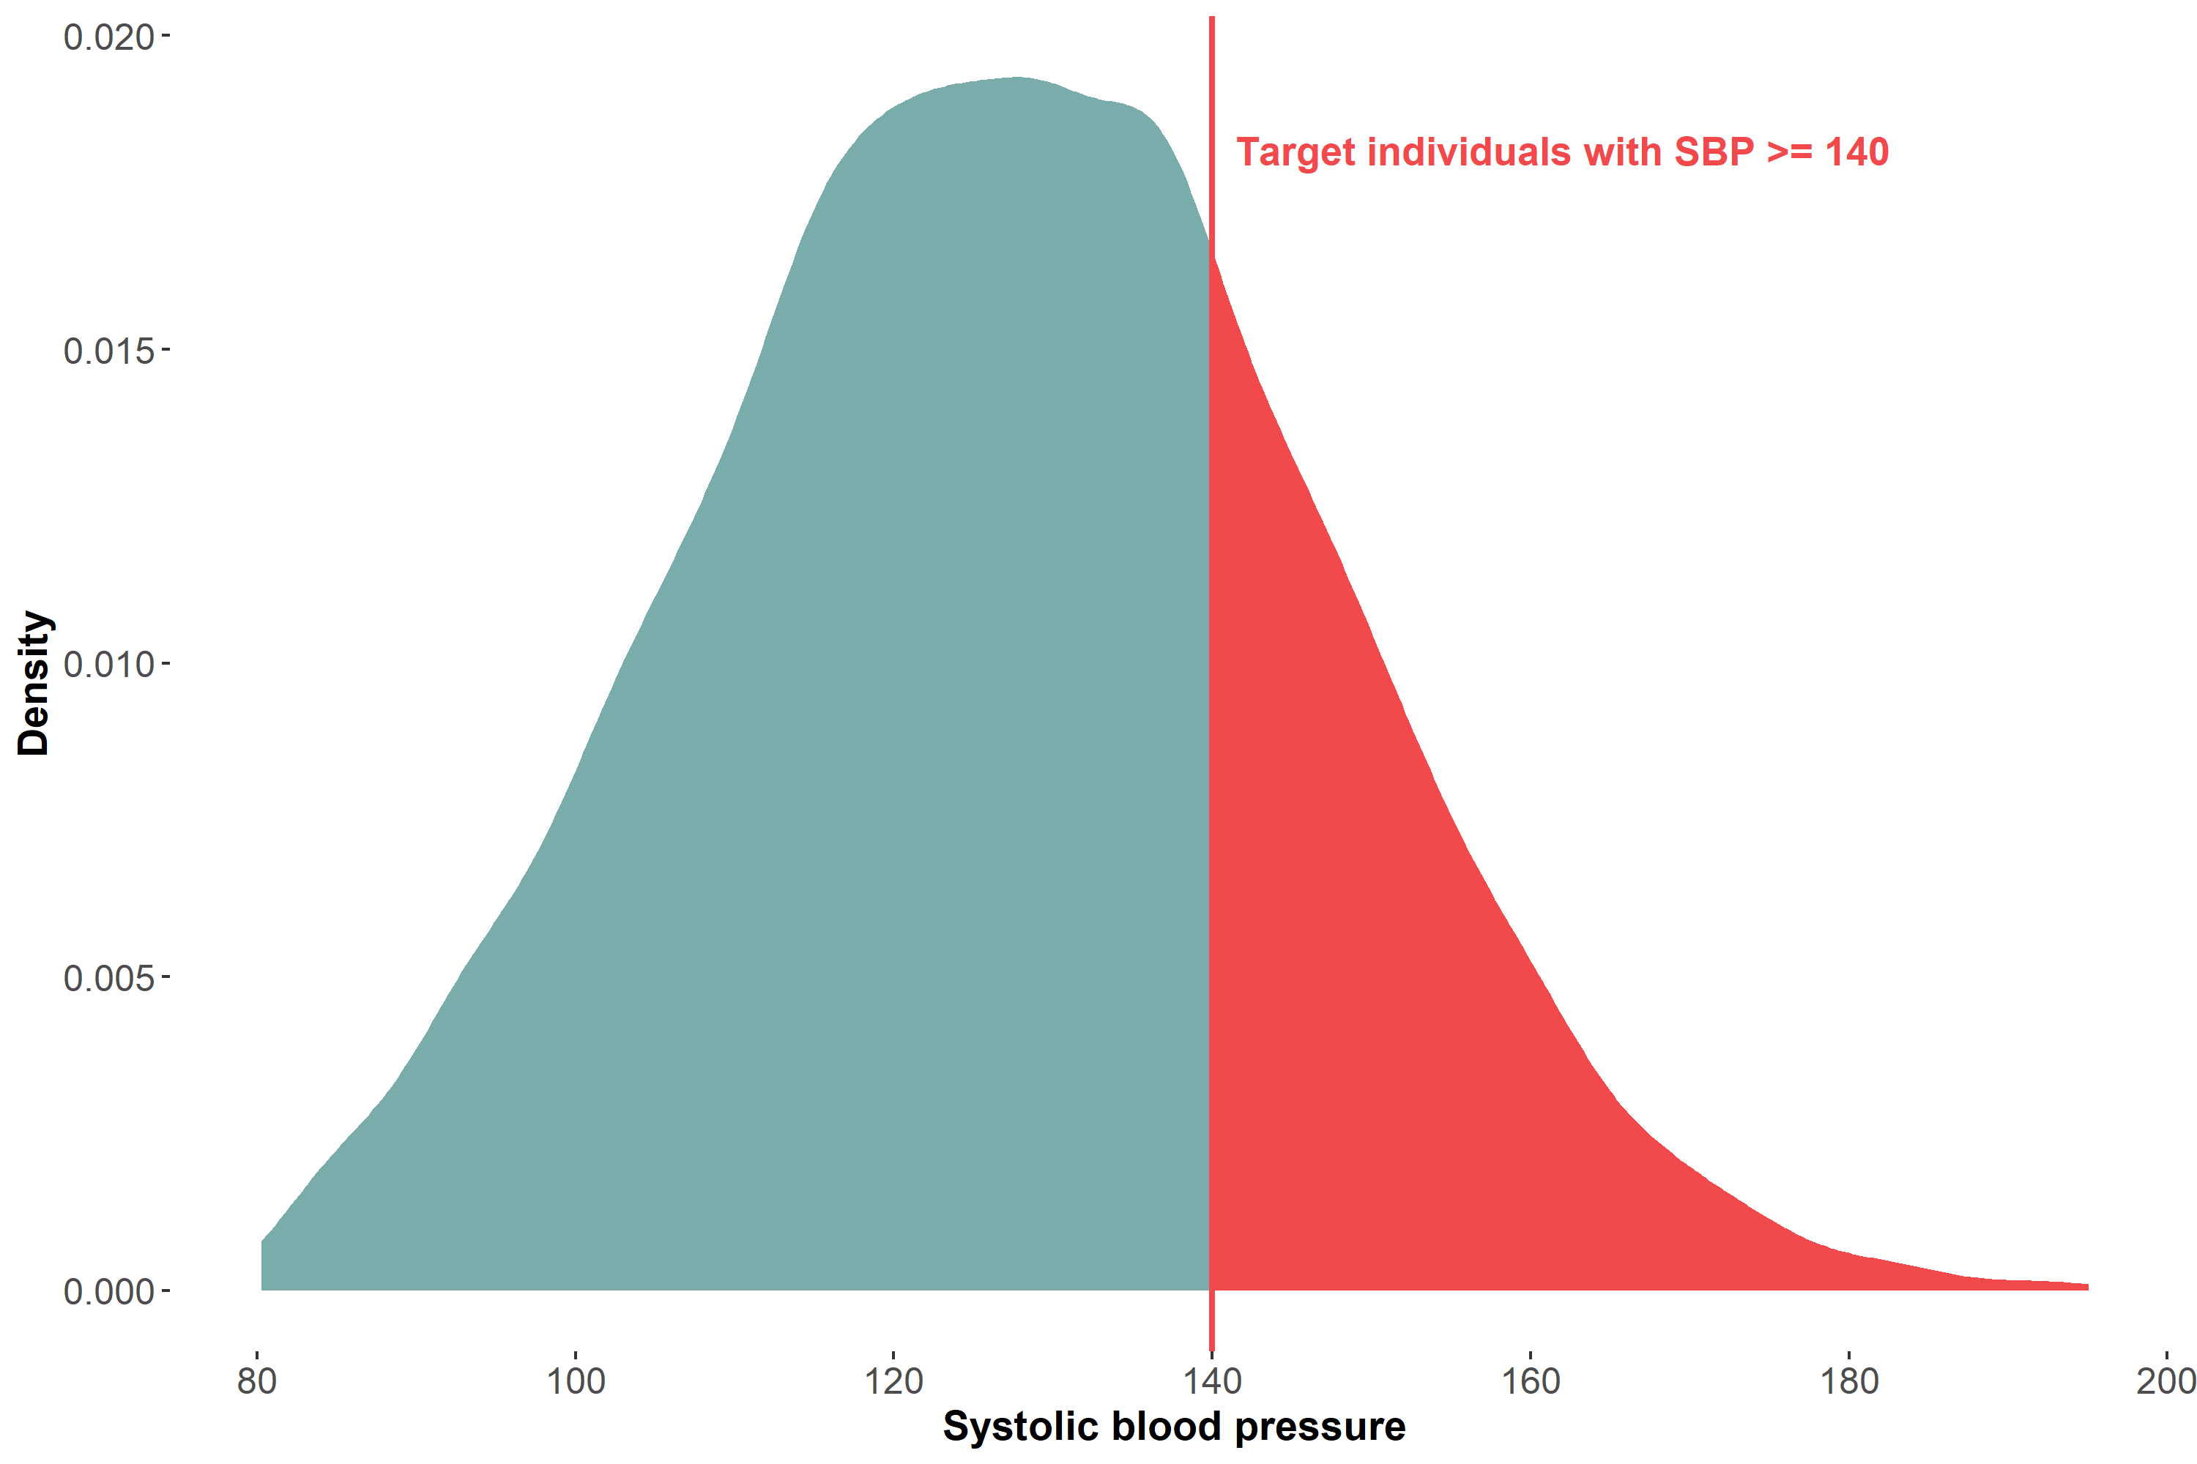
High risk approach for prevention

Slide 28
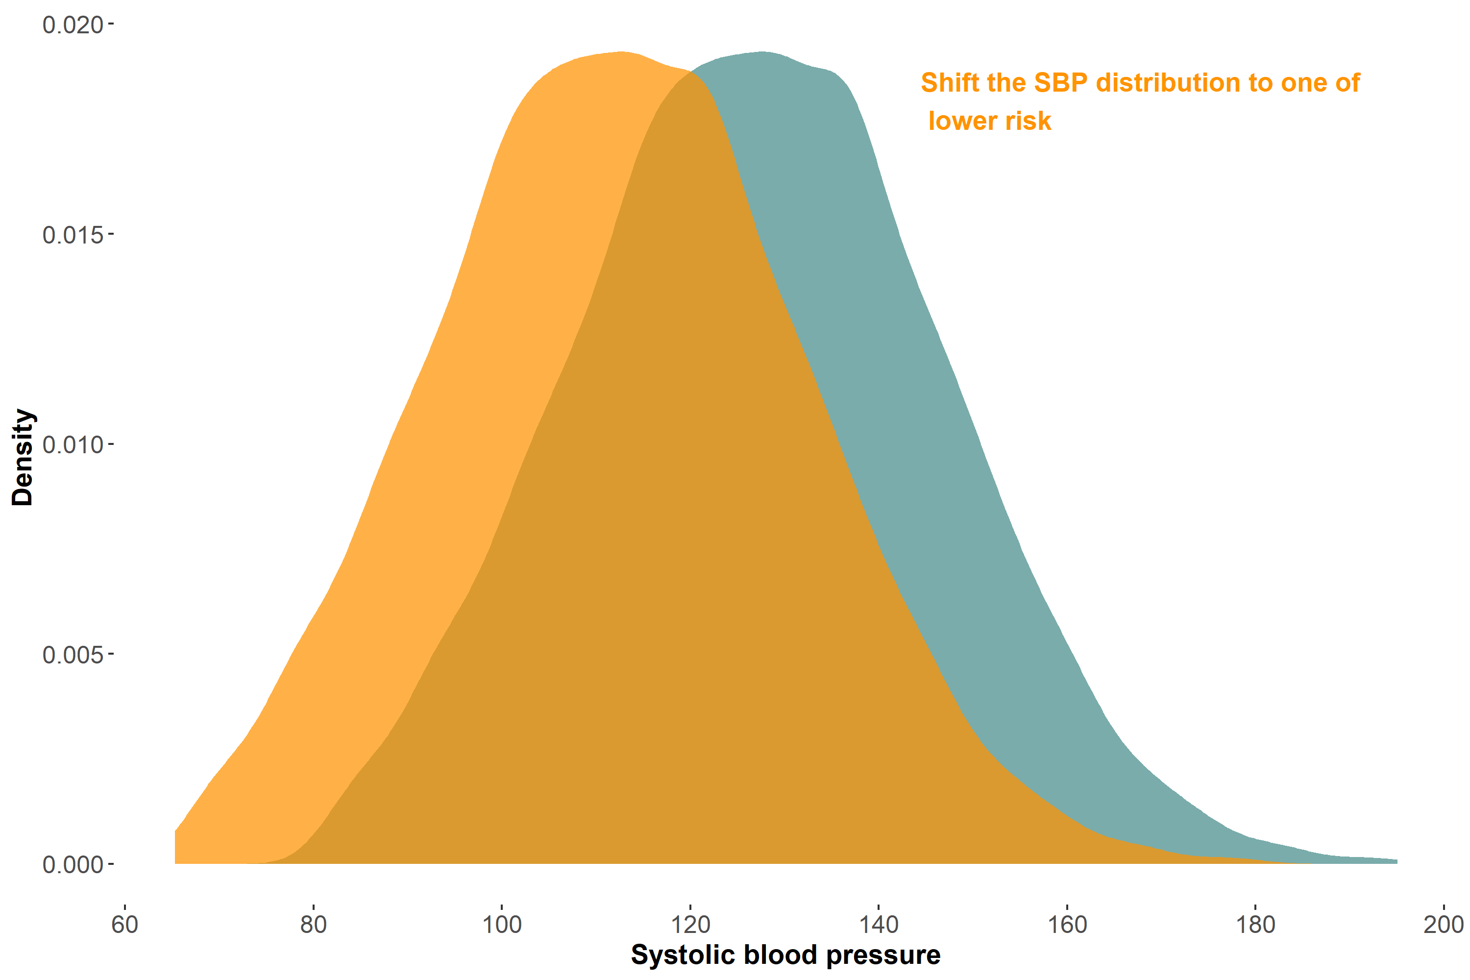
Population approach for prevention

Slide 29
Rose’s framework privileges the mean of a risk factor’s distribution
The study of individual susceptibility is important, but the fundamental questions are, “What determines the population’s mean blood pressure, cholesterol, body weight, and alcohol intake? And how might that mean be changed?”
- Geoffrey Rose (1991). Ancel Keys lecture

Slide 30
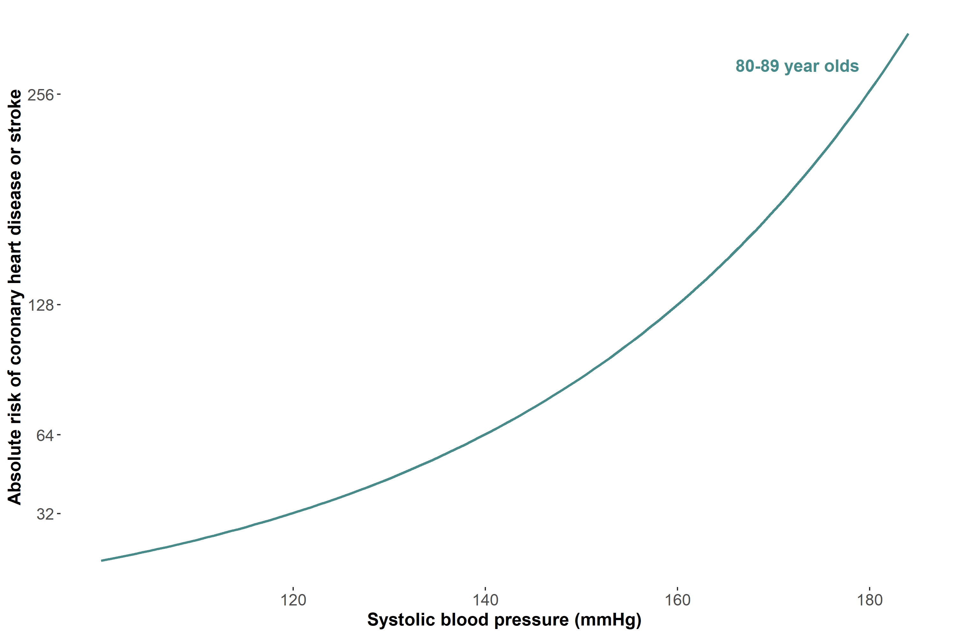
The tails matter too: case of blood pressure
This figure is a recreation of a figure from Fuchs et. al. (2020 with simulated data.
Notes:
Brackets + only systolic

Slide 31
Empirical epidemiology focuses on modeling the outcome mean
Epidemiologists are not exposed to regression models for quantities other than the mean value of an outcome
For a binary outcome, the mean describes the distribution
Output from models not focused on the outcome mean may be trickier to interpret

Slide 32
Can mean models quantify how an exposure affects different parts of the outcome distribution?

Slide 33
Means may tell tall tales about tails (repeat 5 times fast)

Slide 34
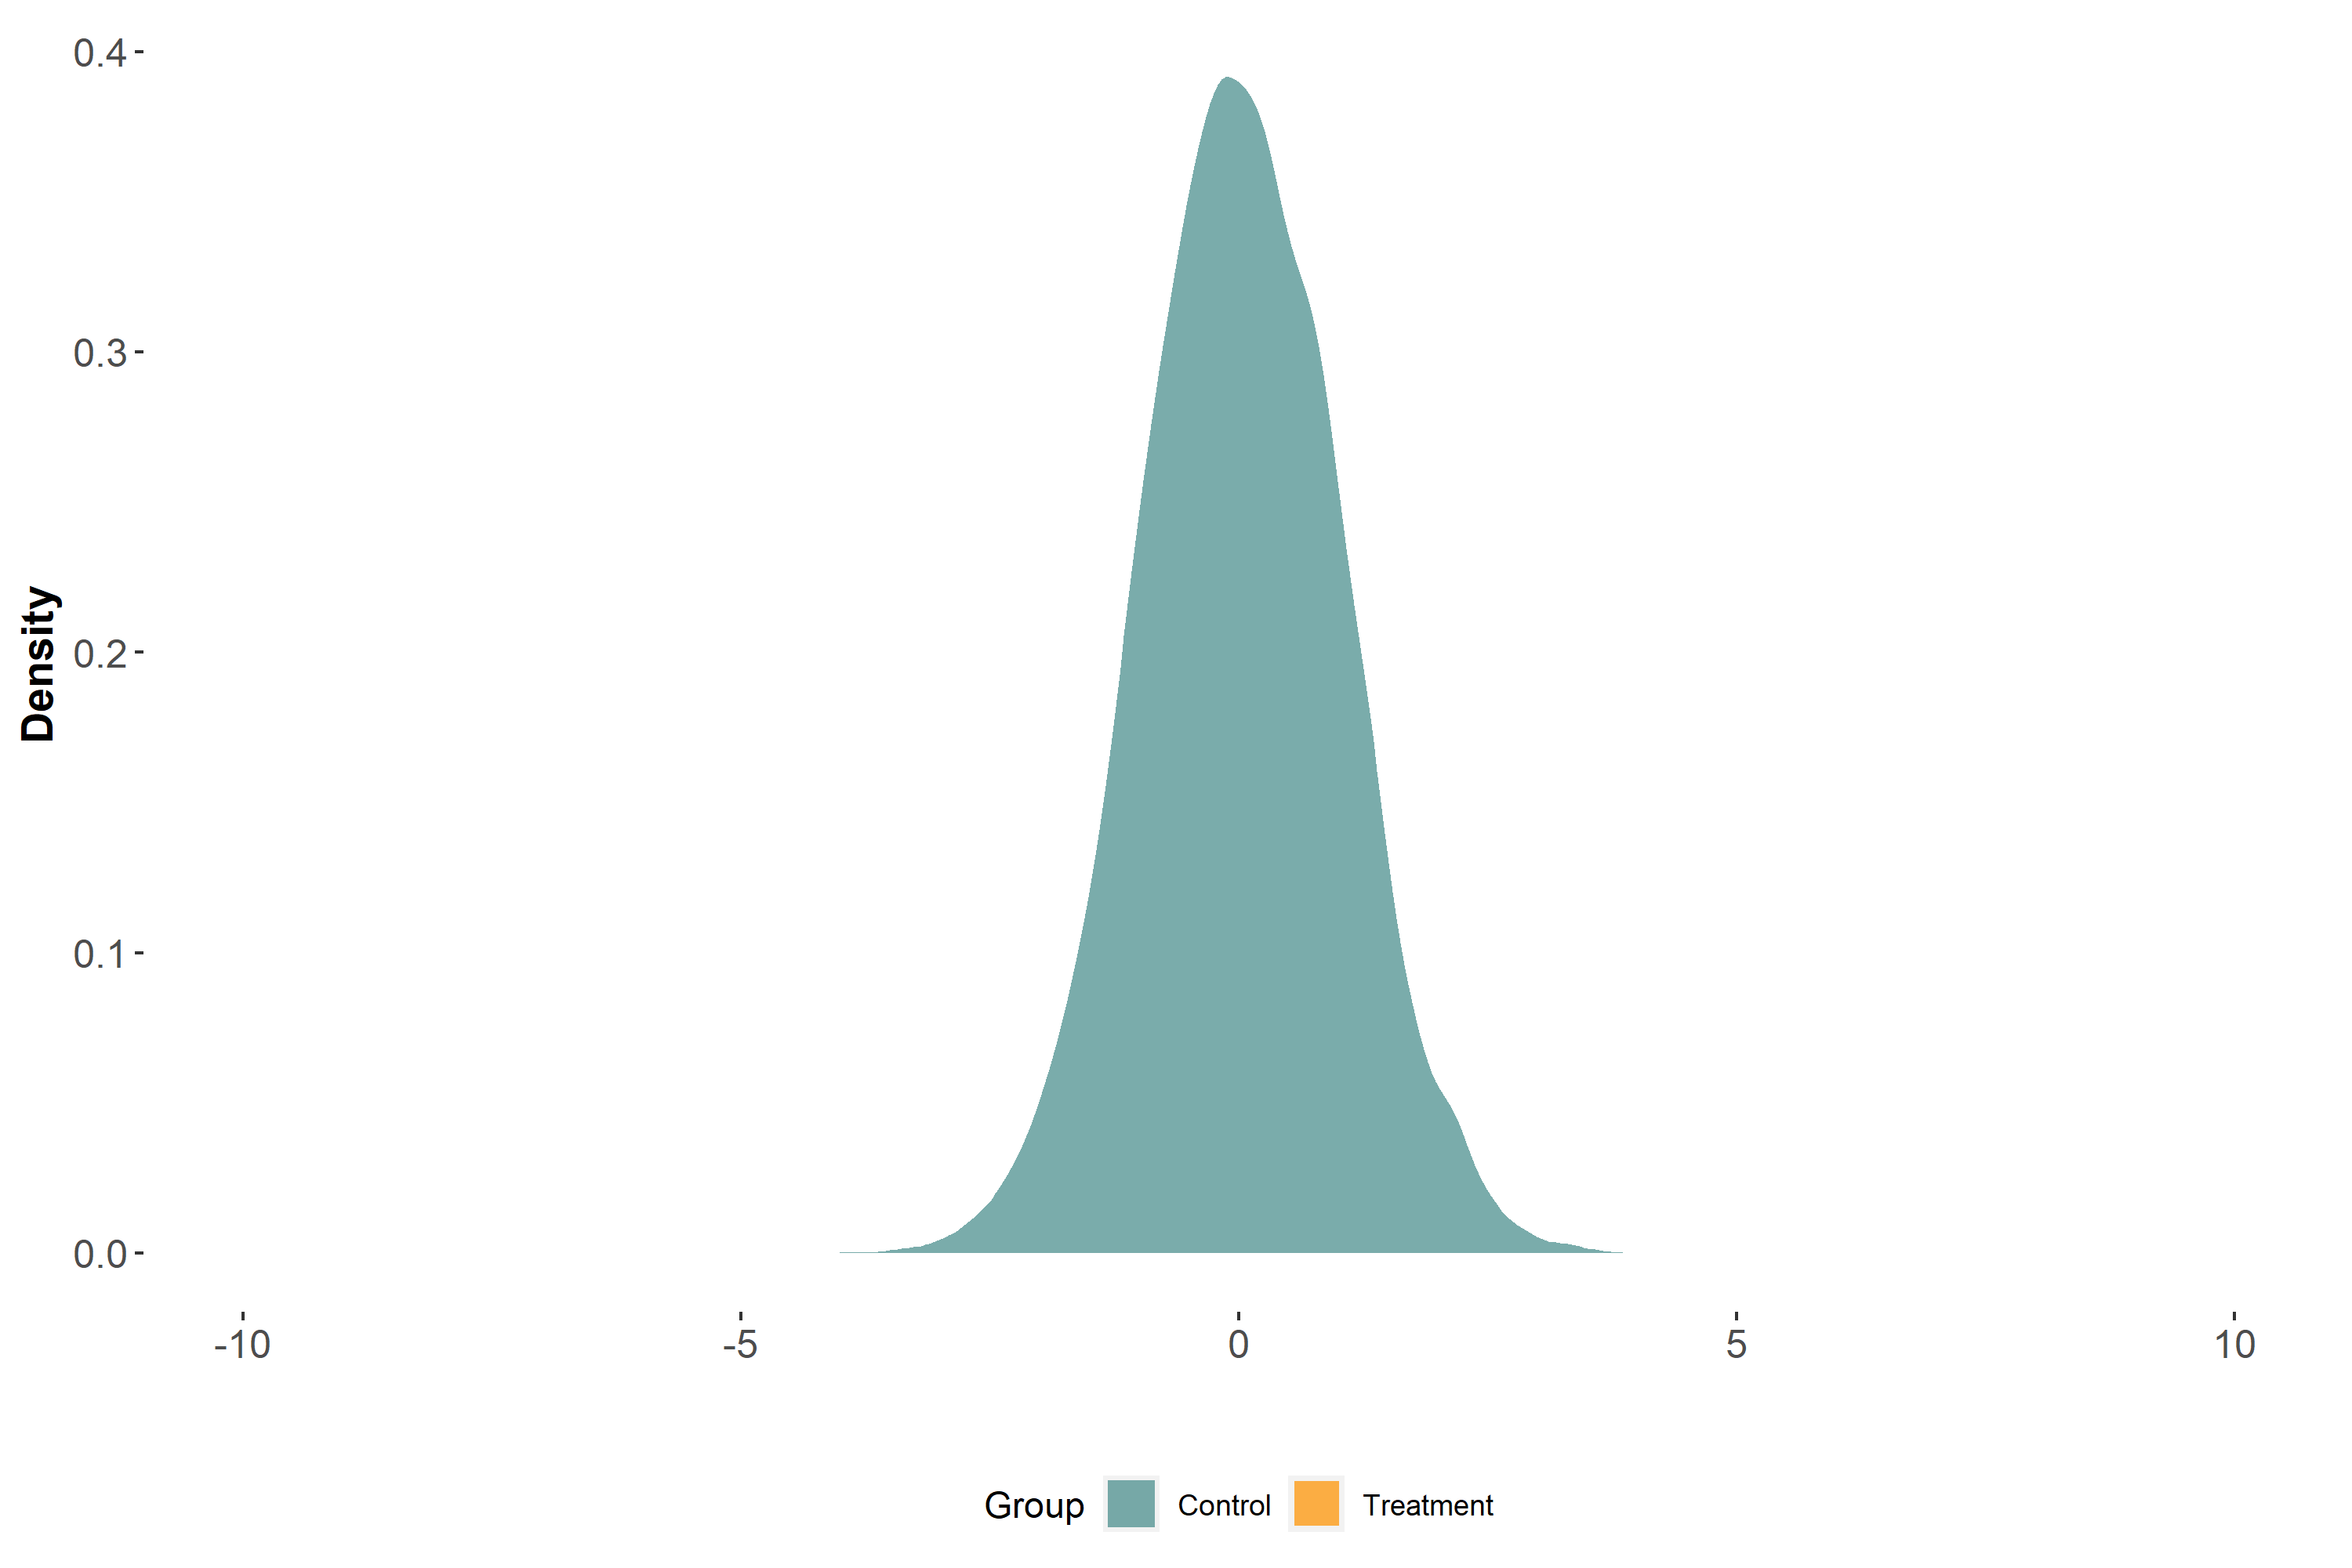
Imagine that a treatment shifts the outcome distribution uniformly

Slide 35
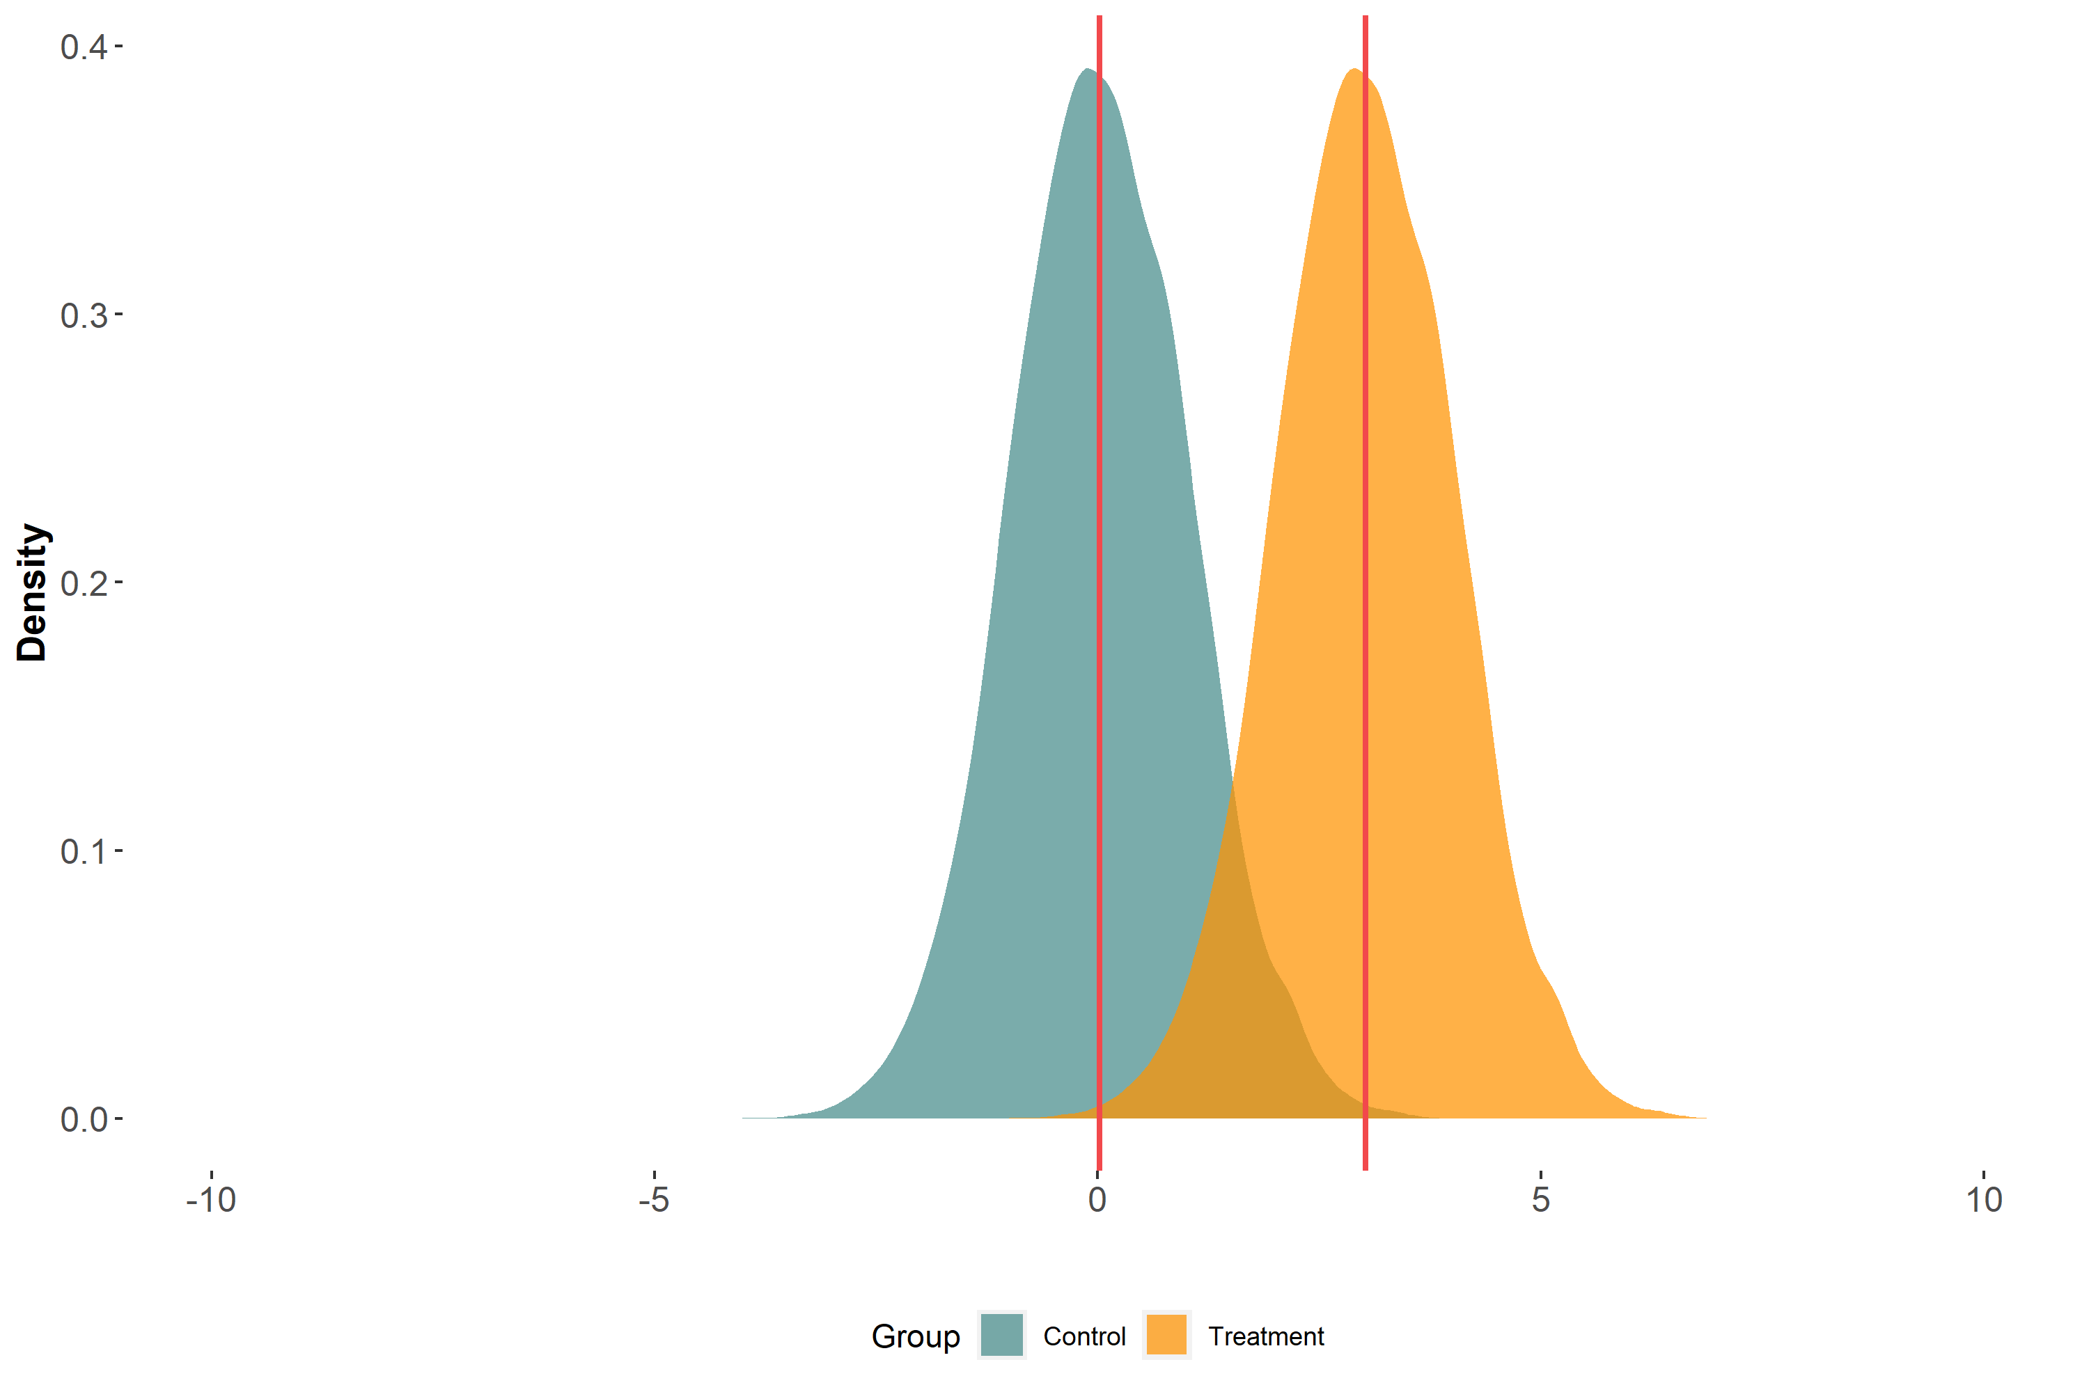
Difference in means

Slide 36
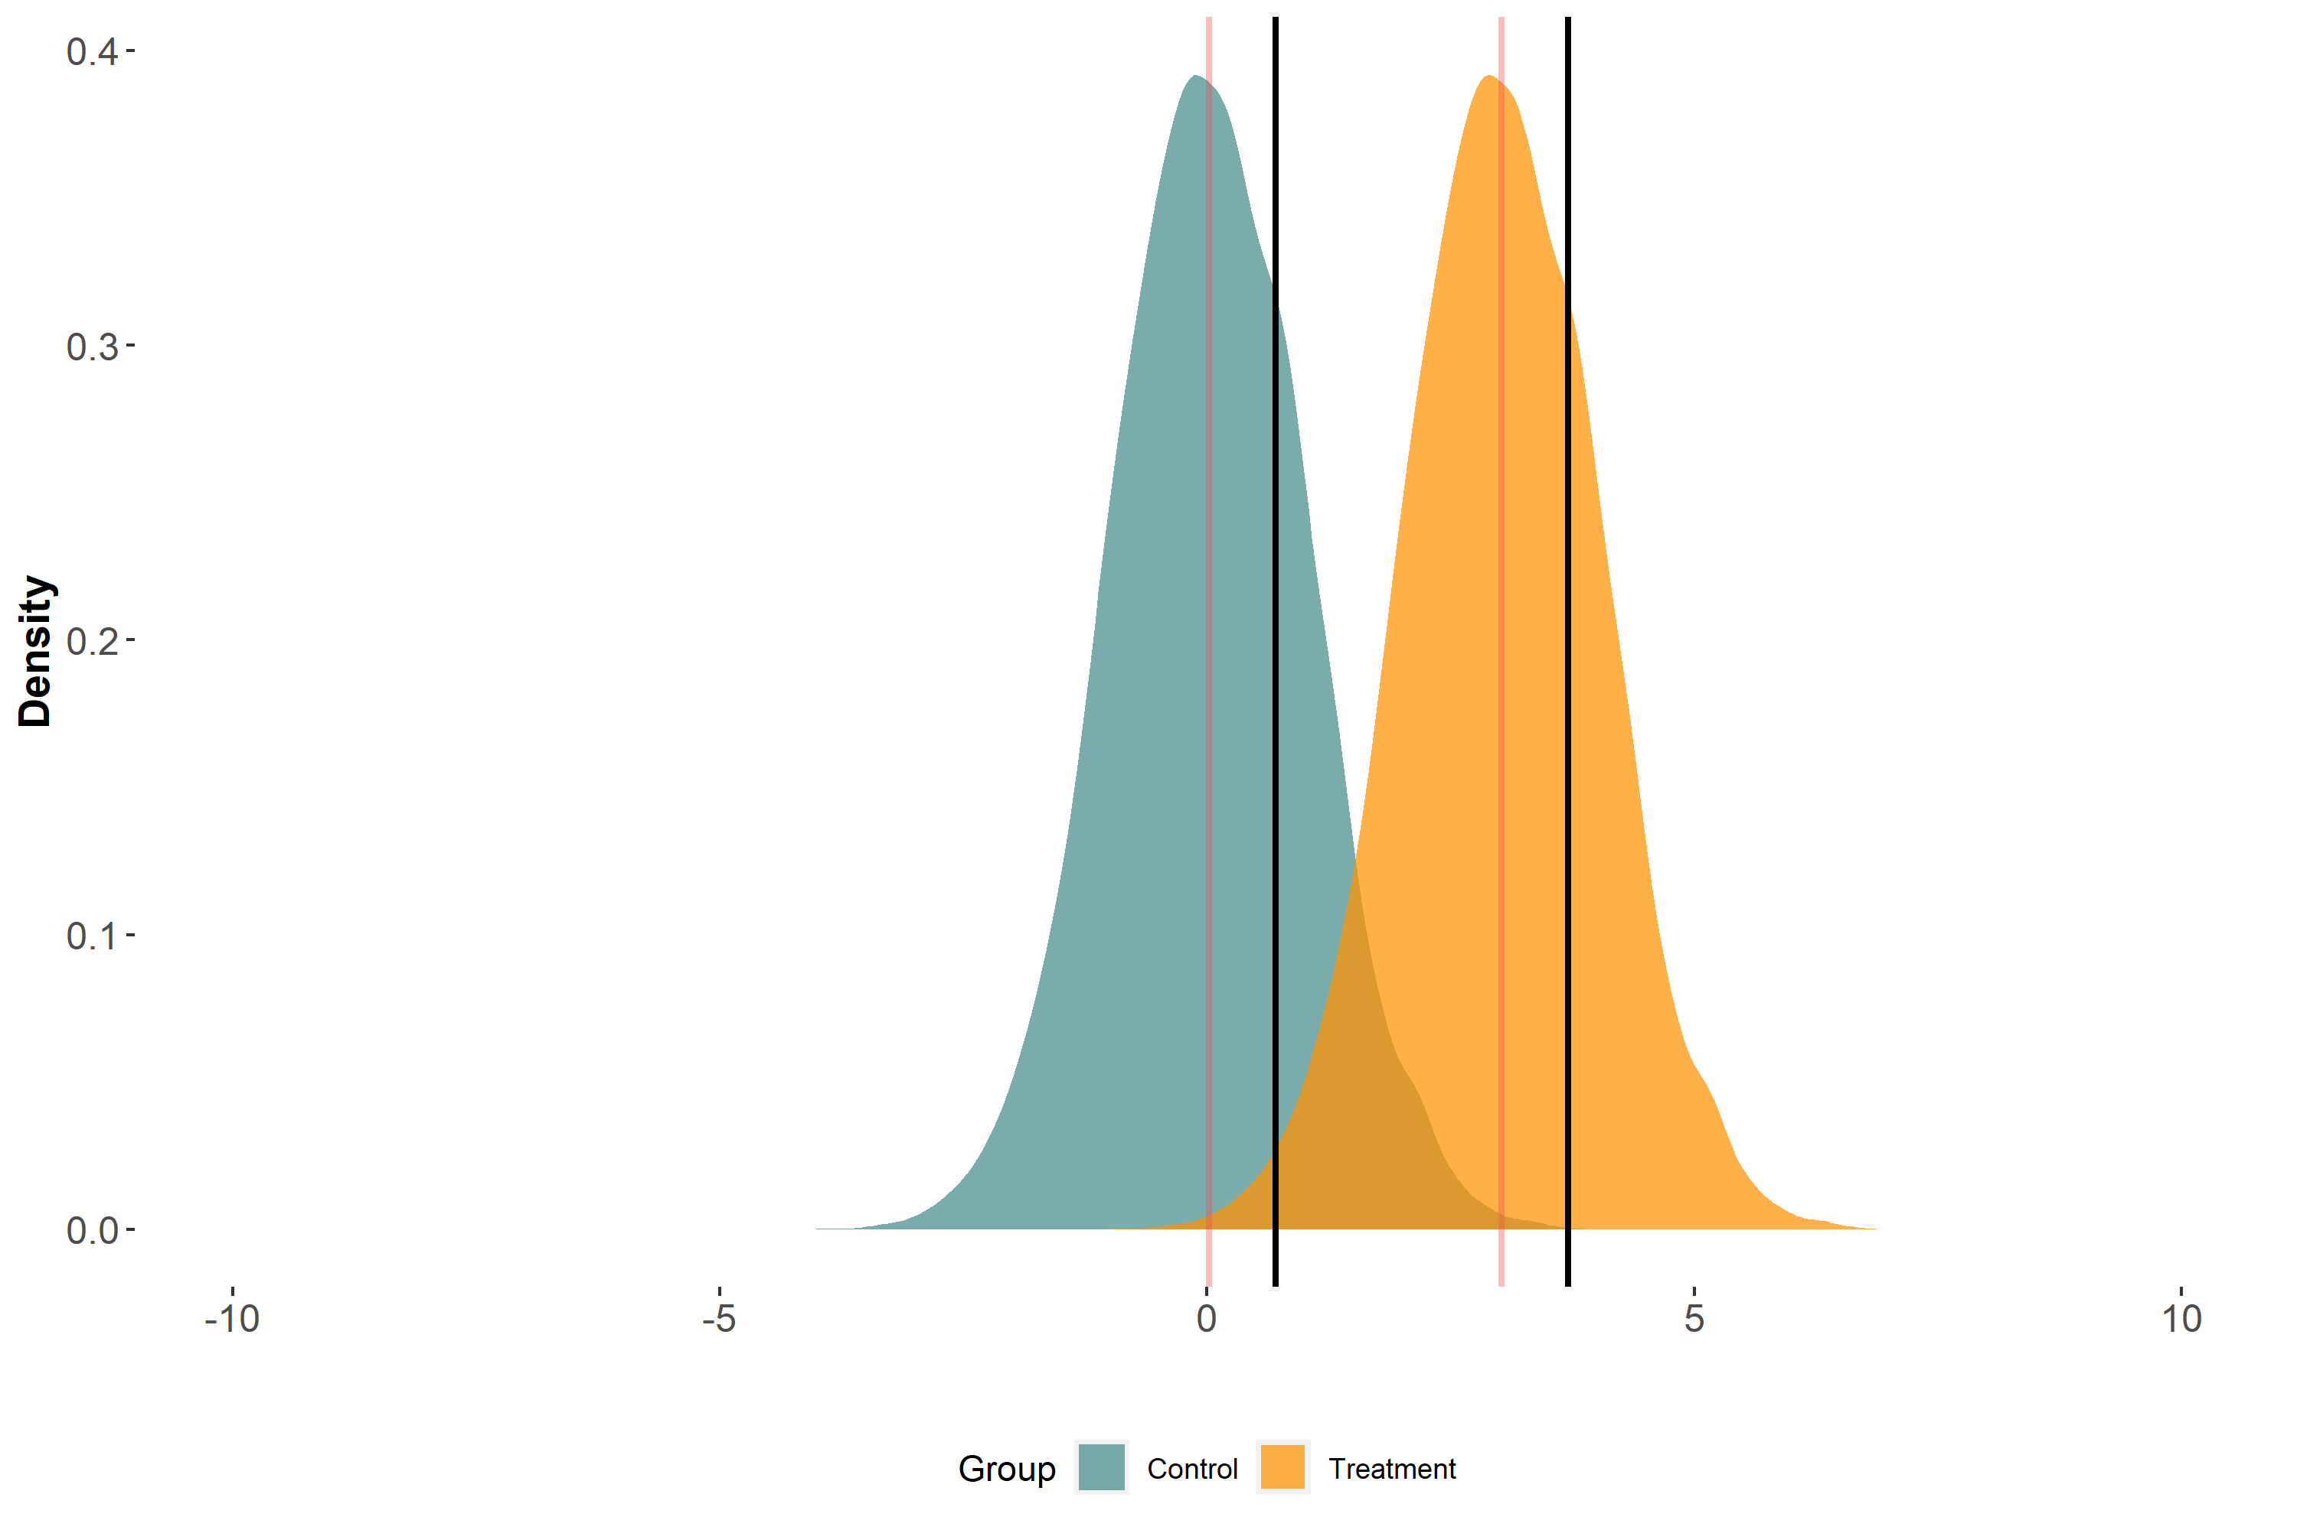
Difference in means = difference in 75th percentiles

Slide 37

Imagine that a treatment affects the outcome distribution’s scale only

Slide 38
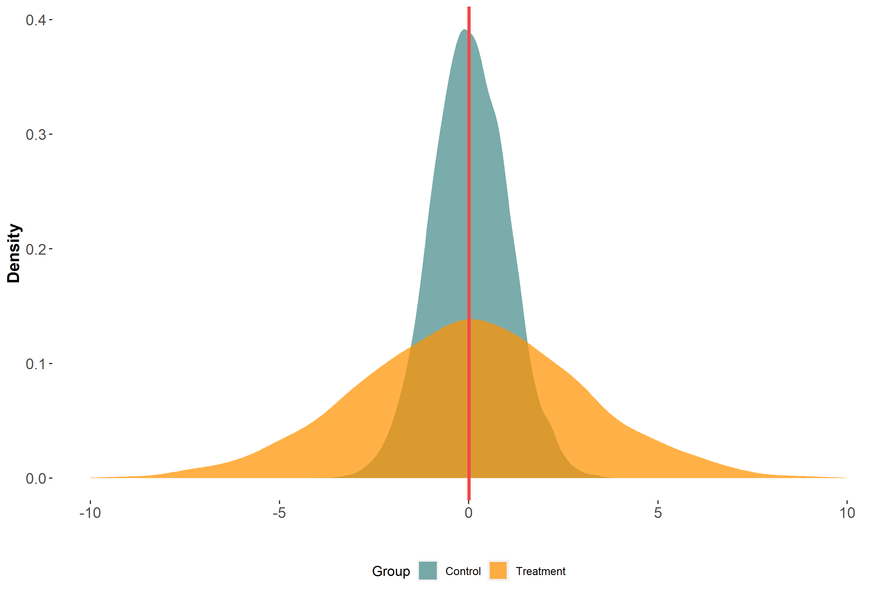
Difference in means

Slide 39
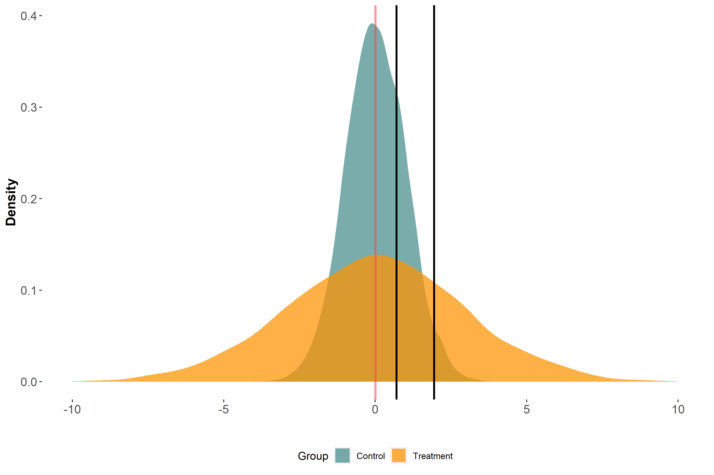
Difference in means ≠ difference in 75th percentiles

Slide 40
Imagine that a treatment affects both the location and scale

Slide 41
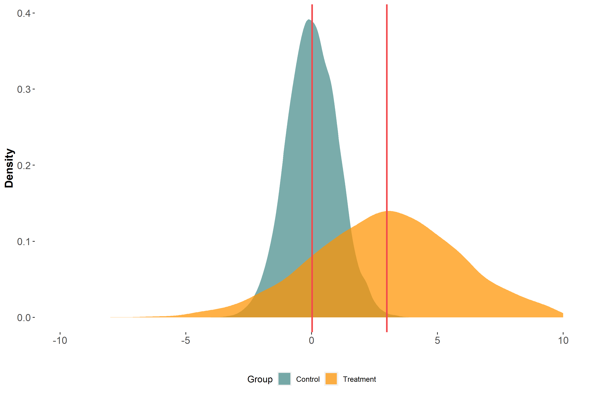
Difference in means

Slide 42

Difference in means ≠ difference in 75th percentiles

Slide 43
Mean models cannot quantify distributional effects when a treatment affects the scale of the outcome distribution

Slide 44
Key takeaways
Investigating how an exposure affects different parts of the outcome distribution, esp. the tails, may be important
Most vulnerable individuals may be in the tails of the distribution
Empirical epidemiology focuses primarily on modeling the outcome mean
Mean models are limited in their ability to quantify effects across the outcome distribution

Slide 45
A brewing battle between means and quantiles
i.e., a review of means and quantiles

Slide 46
Learning aims
Mean:
Unconditional and conditional means (concept + estimation)
Law of Iterated Expectations
Quantiles
Unconditional and conditional quantiles (concept + estimation)
Law of Iterated Quantiles?

Slide 47
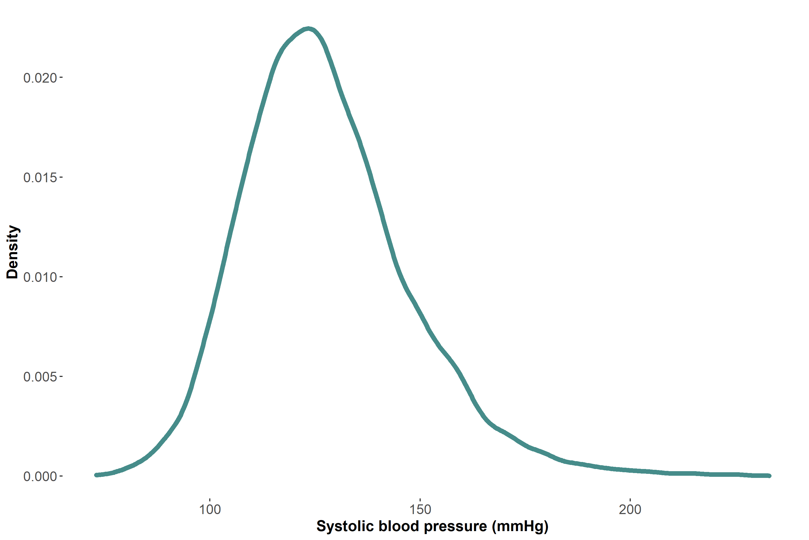
Empirical unconditional distribution of SBP in our data

Slide 48
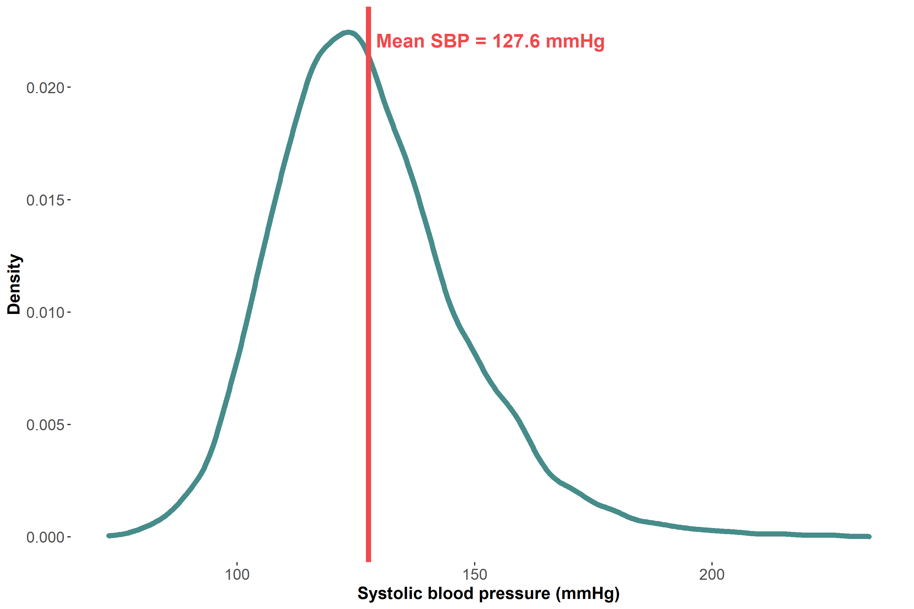
(Arithmetic) Mean of the empirical unconditional SBP distribution

Slide 49
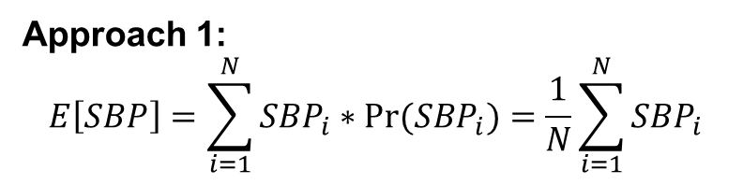
How can we estimate the mean of the unconditional SBP distribution?
Approach 1:
$$E\left[SBP\right]=\sum_{i=1}^{N}{SBP_{i}∗Pr⁡(SBP_{i})}=\frac{1}{N}\sum_{i=1}^{N}{SBP_{i}}$$

Slide 50
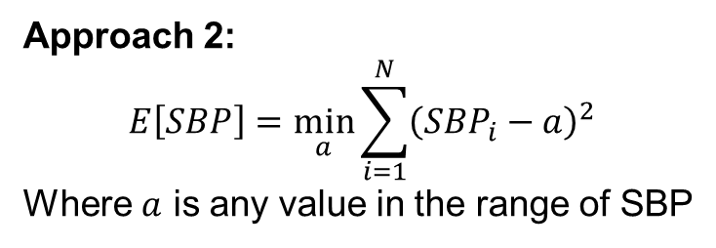
How can we estimate the mean of the unconditional SBP distribution?
Approach 1:
$$E\left[SBP\right]=\sum_{i=1}^{N}{SBP_{i}∗Pr⁡(SBP_{i})}=\frac{1}{N}\sum_{i=1}^{N}{SBP_{i}}$$
Approach 2:
$$E\left[SBP\right]=\min_{a}{\sum_{i=1}^{N}{{\left(SBP_{i}−a\right)}^{2}}}$$
Where $a$ is any value in the range of SBP

Slide 51
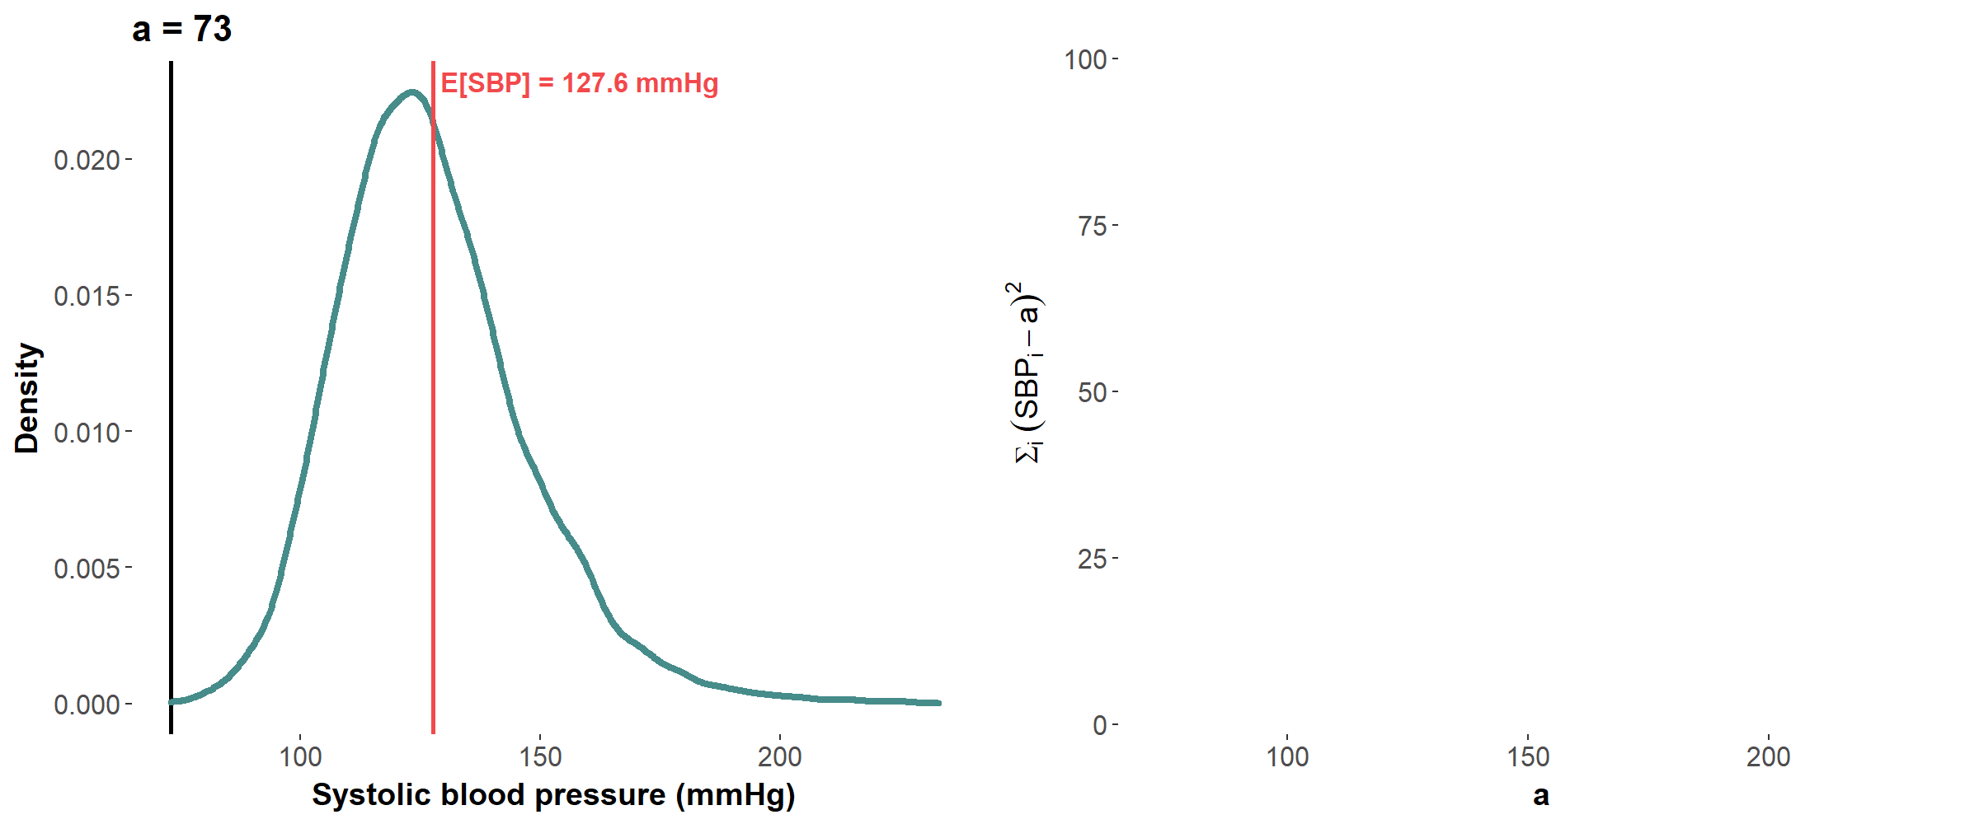
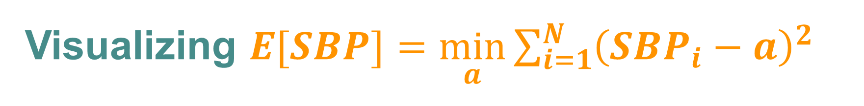
Visualizing $E[SBP]=\min_{a}{\sum_{i=1}^{N}{{\left(SBP_{i}−a\right)}^{2}}}$

Slide 52
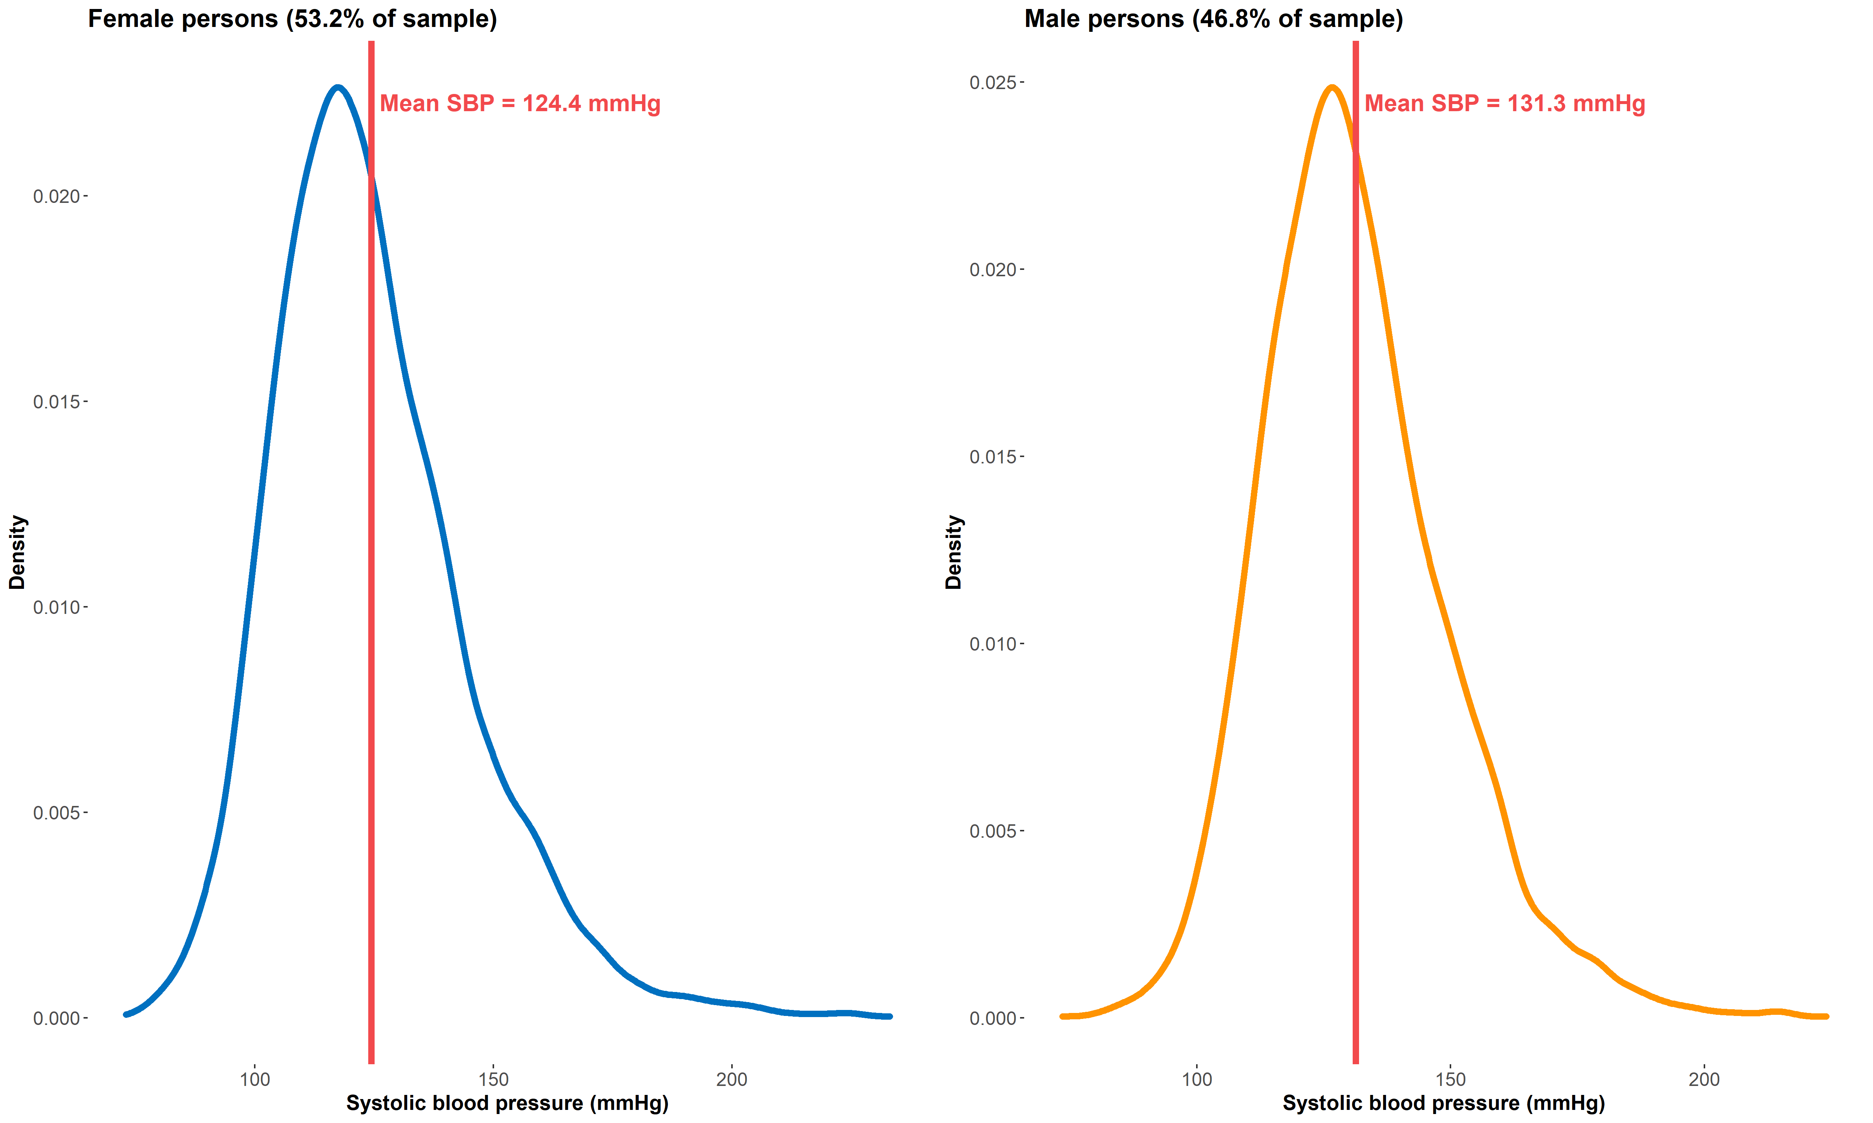
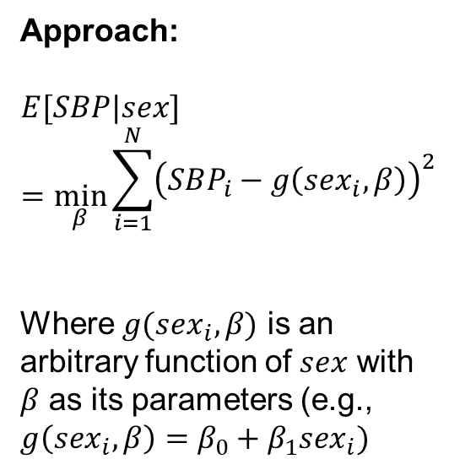
Mean SBP conditional on self-identified sex
Approach:
$$E[SBP|sex]=\min_{β}{\begin{aligned}\sum_{i=1}^{N}{{\left(SBP_{i}−g\left(sex_{i},β\right)\right)}^{2}} \\ \end{aligned}}$$
Where $g(sex_{i},β)$ is an arbitrary function of $sex$ with $β$ as its parameters (e.g., ${g\left(sex_{i},β\right)=β}_{0}+β_{1}sex_{i})$

Slide 53
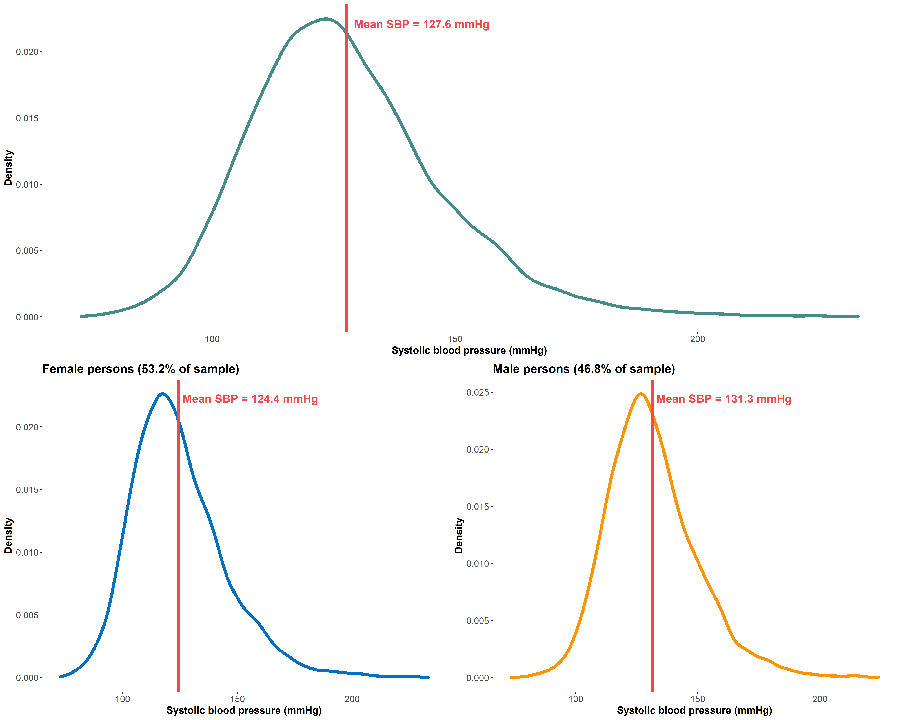
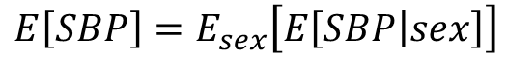
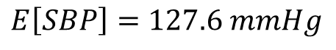

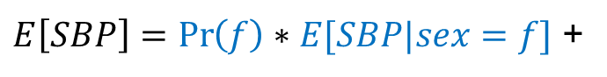
The Law of Iterated Expectations
$$E\left[SBP\right]=E_{sex}\left[E\left[SBP | sex\right]\right]$$
$E\left[SBP\right]=\operatorname{Pr}\left(f\right)∗E[SBP|sex=f]$ +
$E\left[SBP\right]=\operatorname{Pr}\left(m\right)∗E[SBP|sex=m]$
$$E\left[SBP\right]=0.532∗124.4+0.468∗131.3$$
$$E\left[SBP\right]=127.6 mmHg$$

Slide 54
The Law of Iterated Expectations allows us to determine the mean of the unconditional distribution using information on the means of the conditional distribution

Slide 55
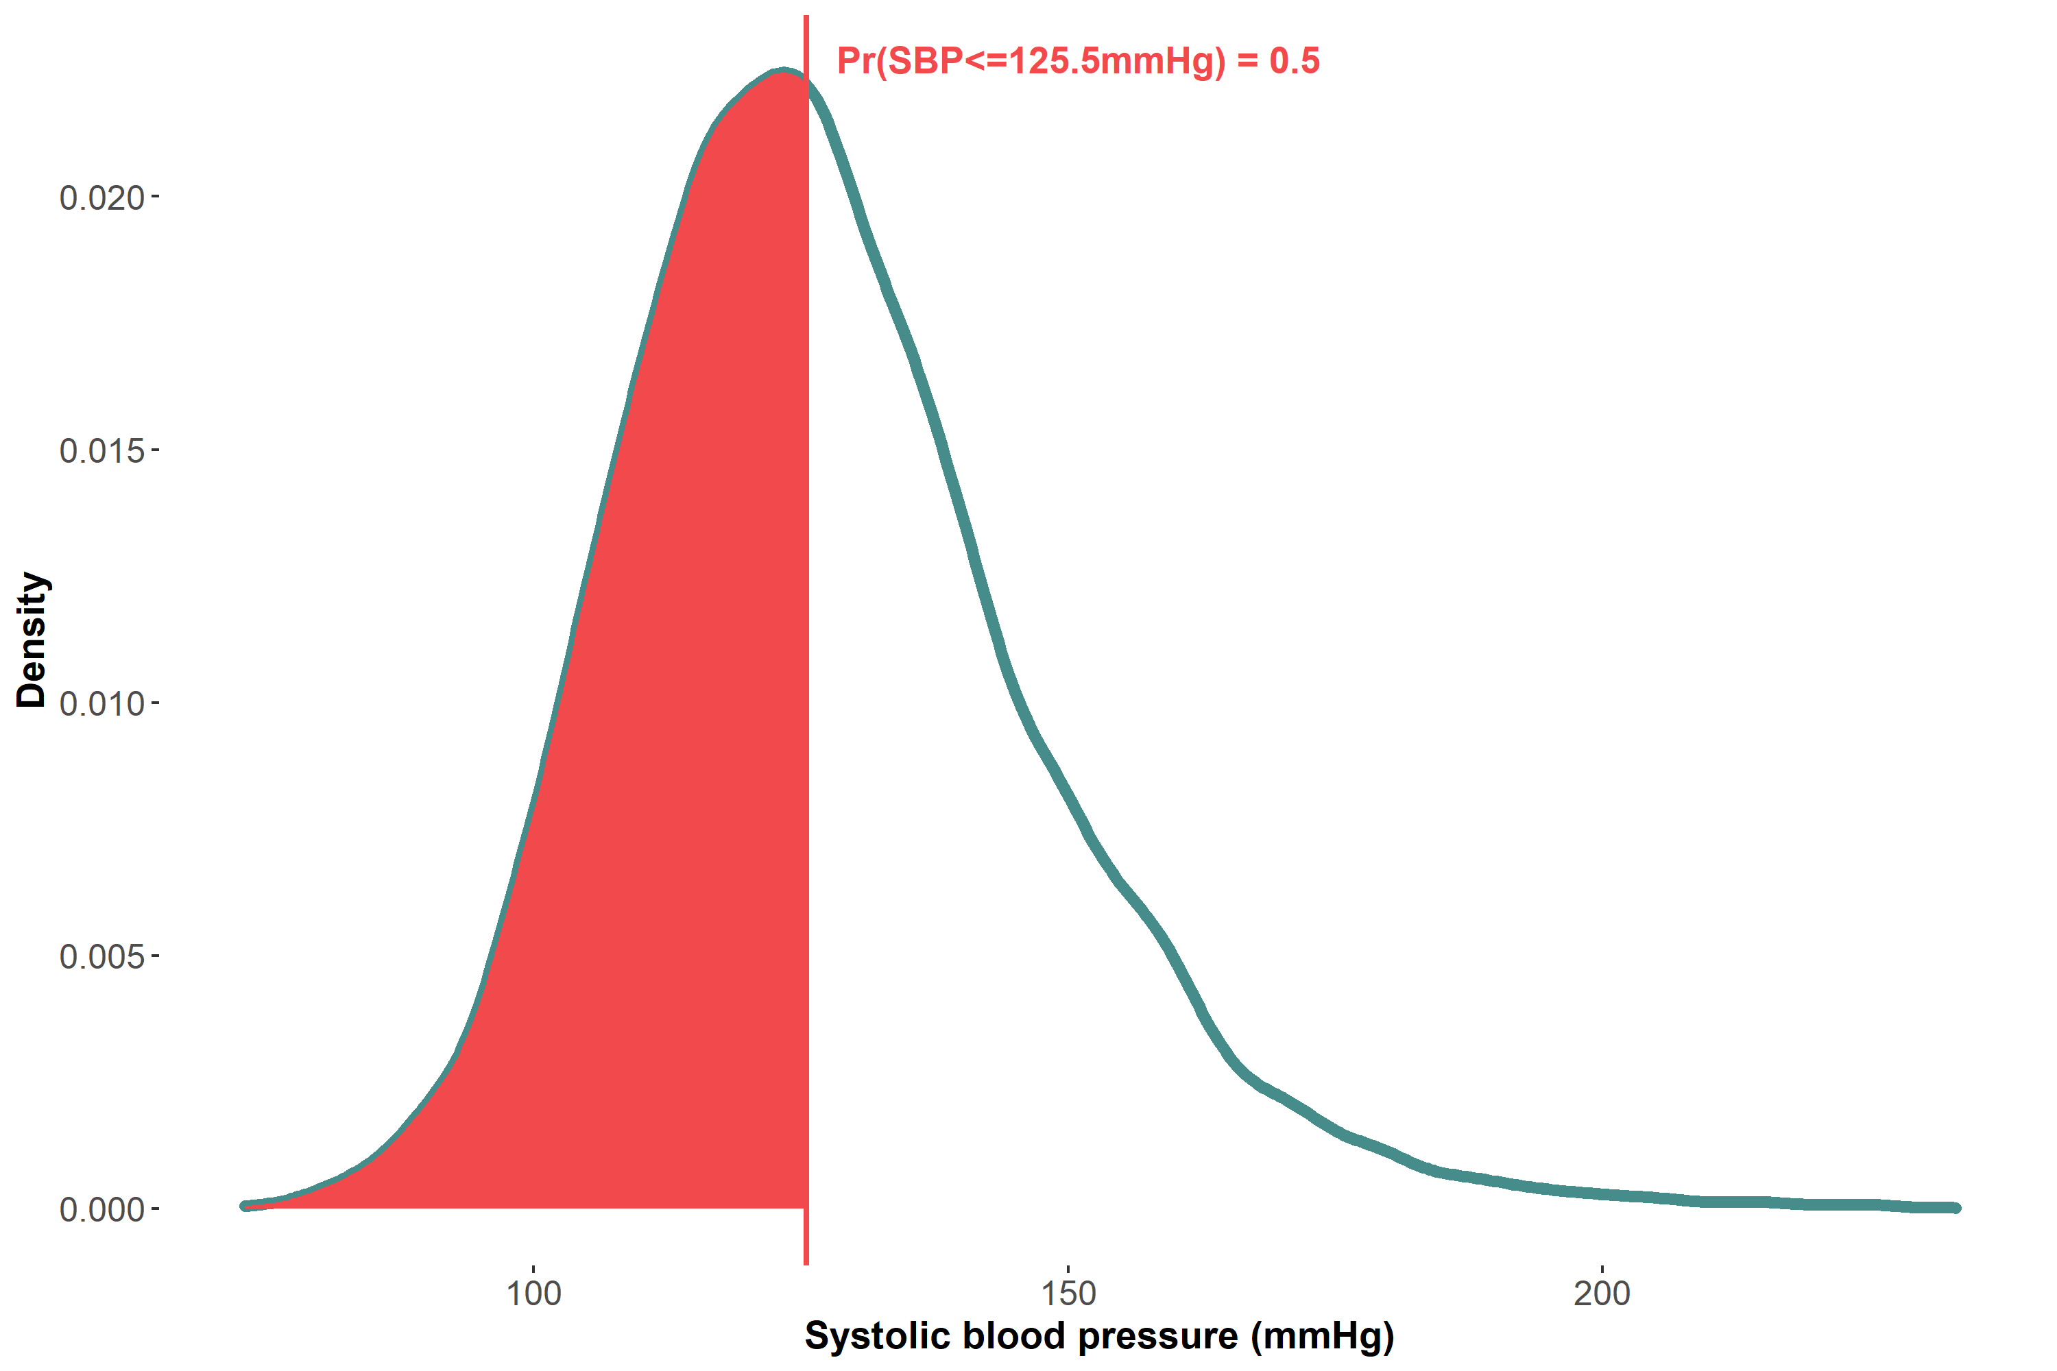
50th quantile is the value of SBP such that 50% of values lie below it
50th quantile = median

Slide 56
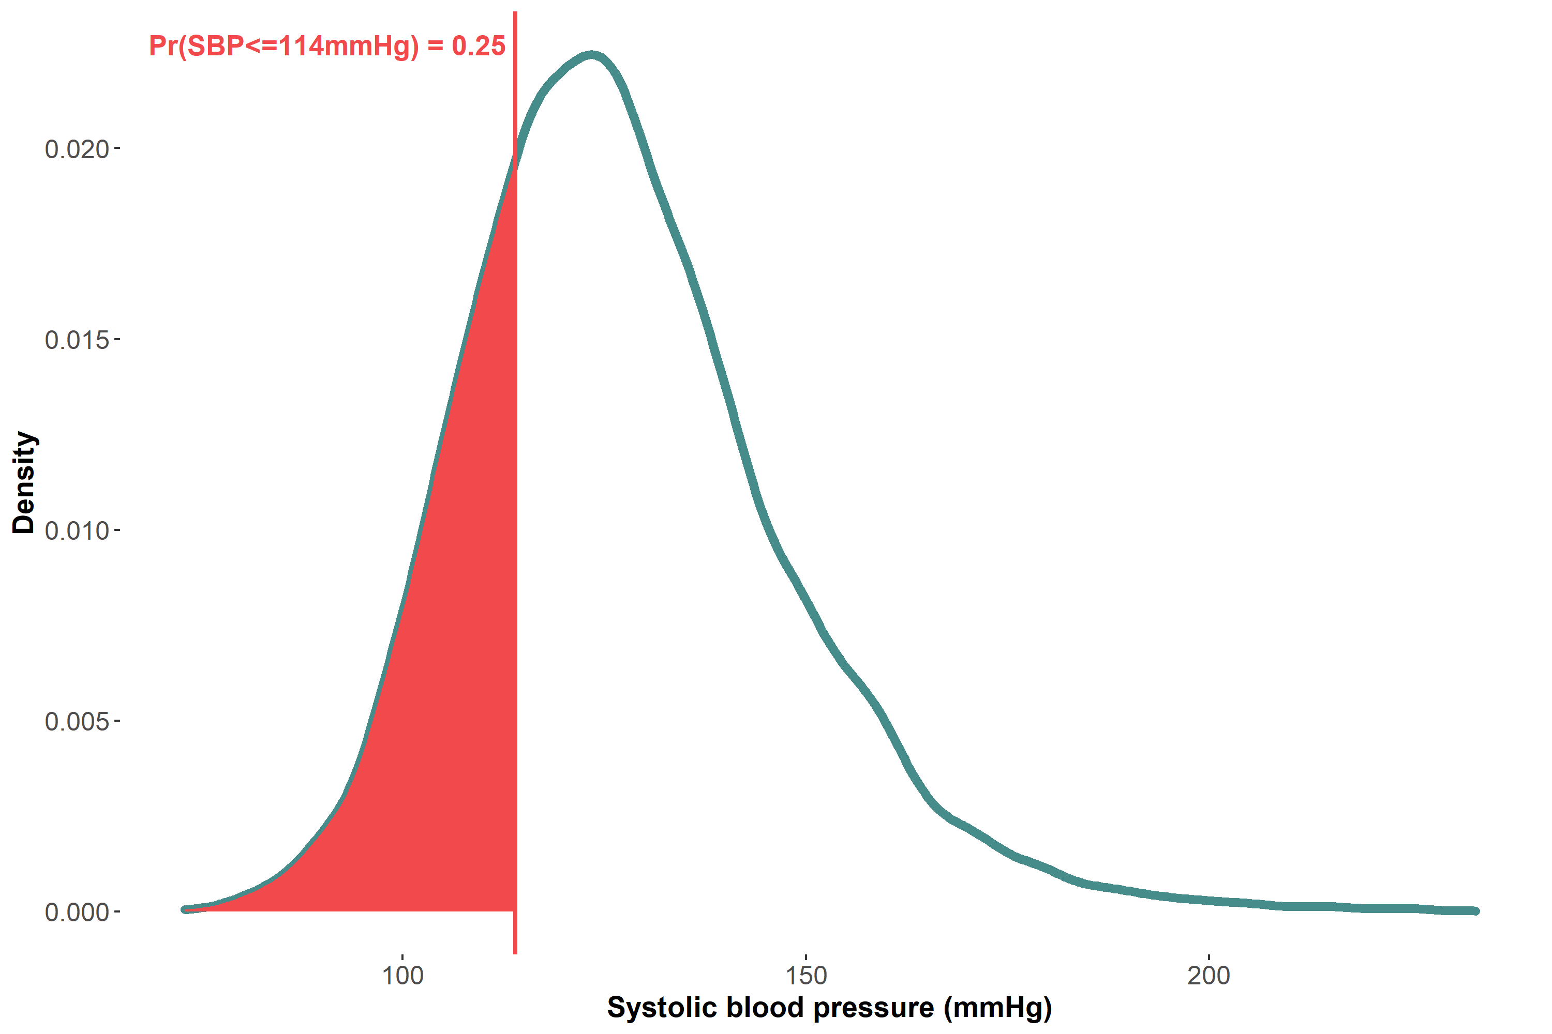
25th quantile is the value of SBP such that 25% of values lie below it

Slide 57
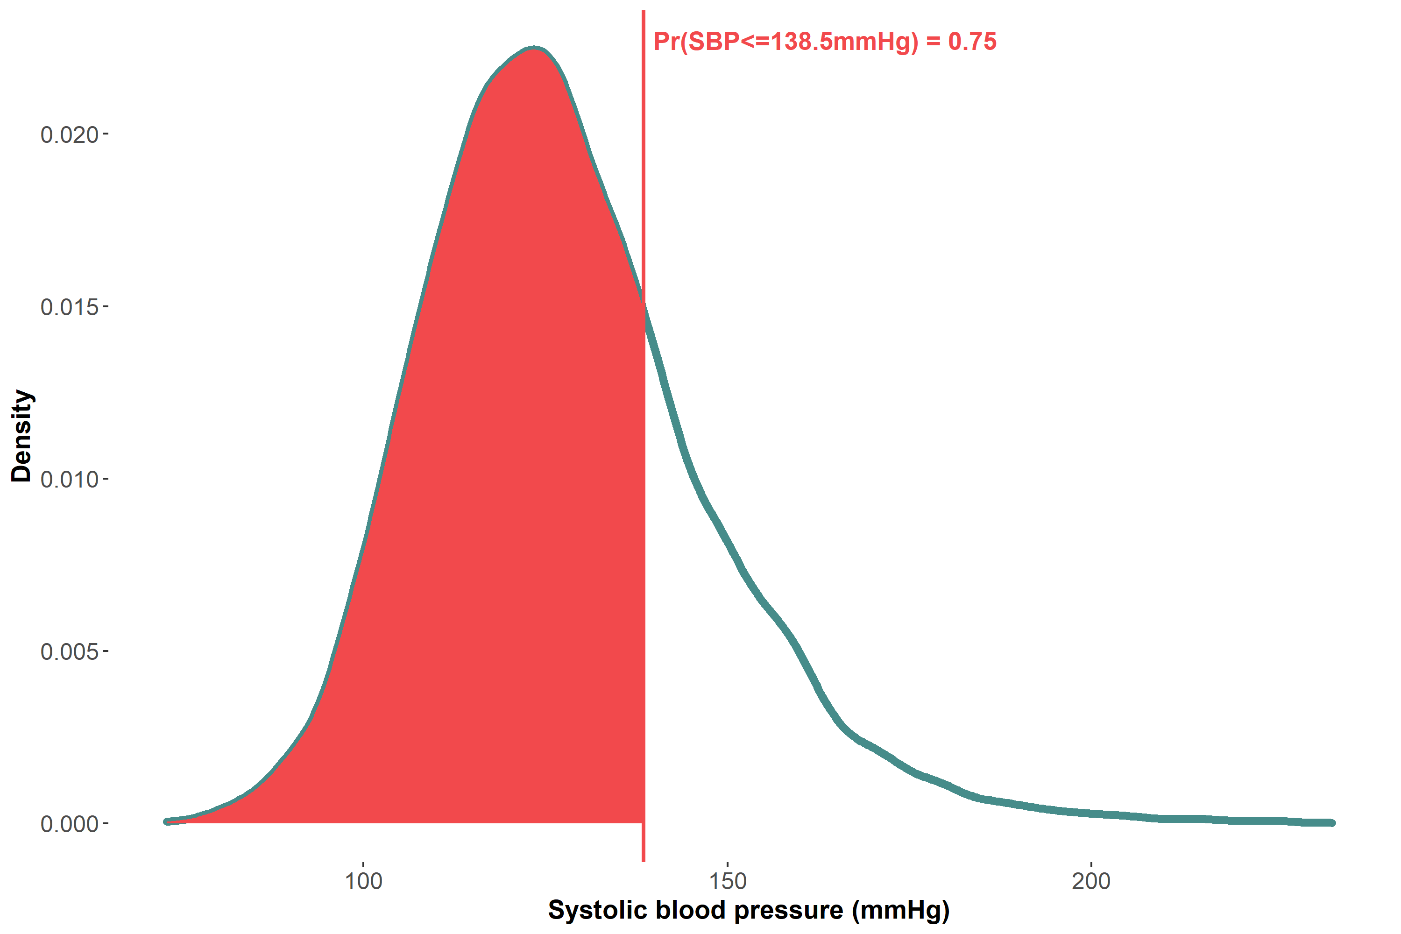
75th quantile is the value of SBP such that 75% of values lie below it

Slide 58
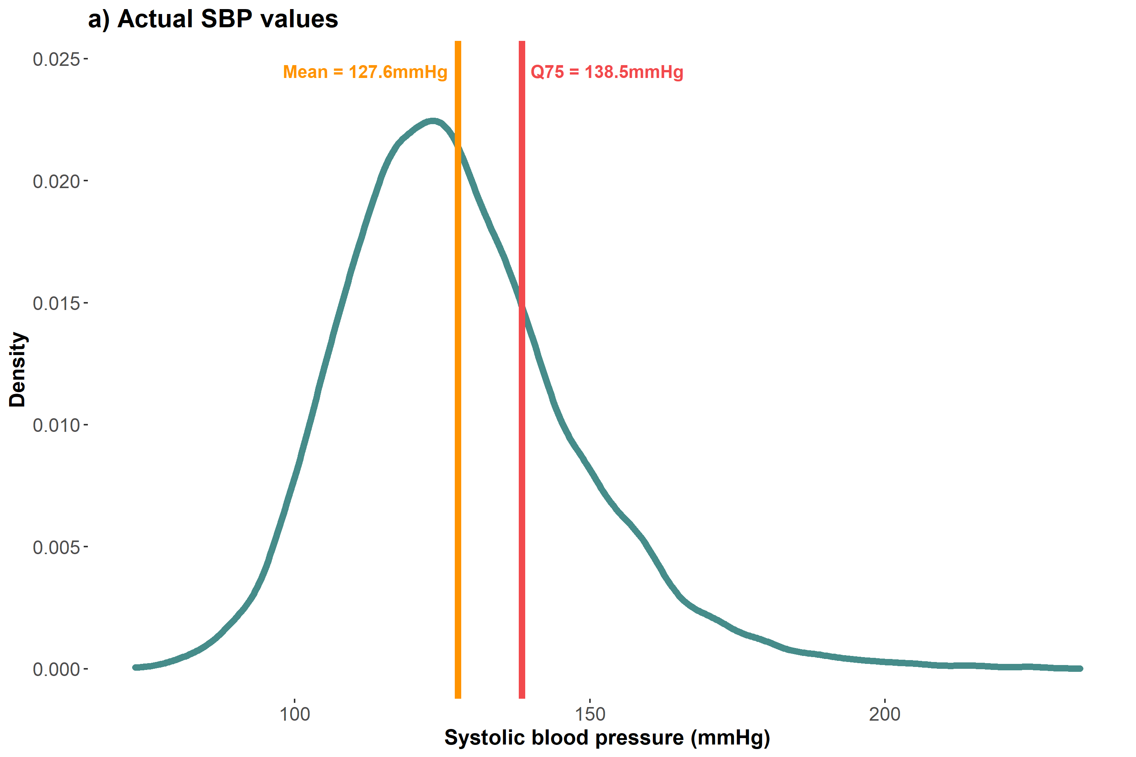
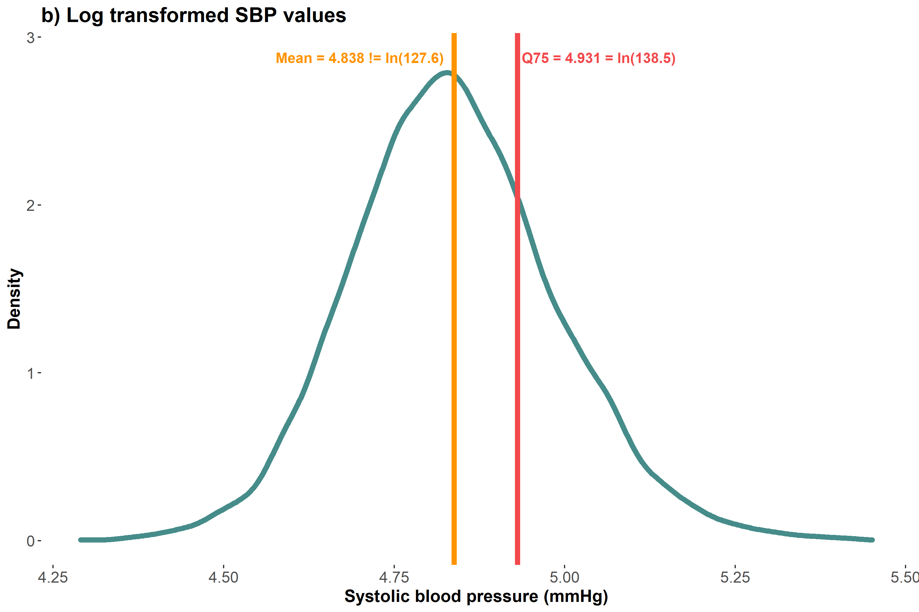
Robust quantiles: Equivariance to monotonic transformations 💪🏾💪🏼💪🏾

Slide 59
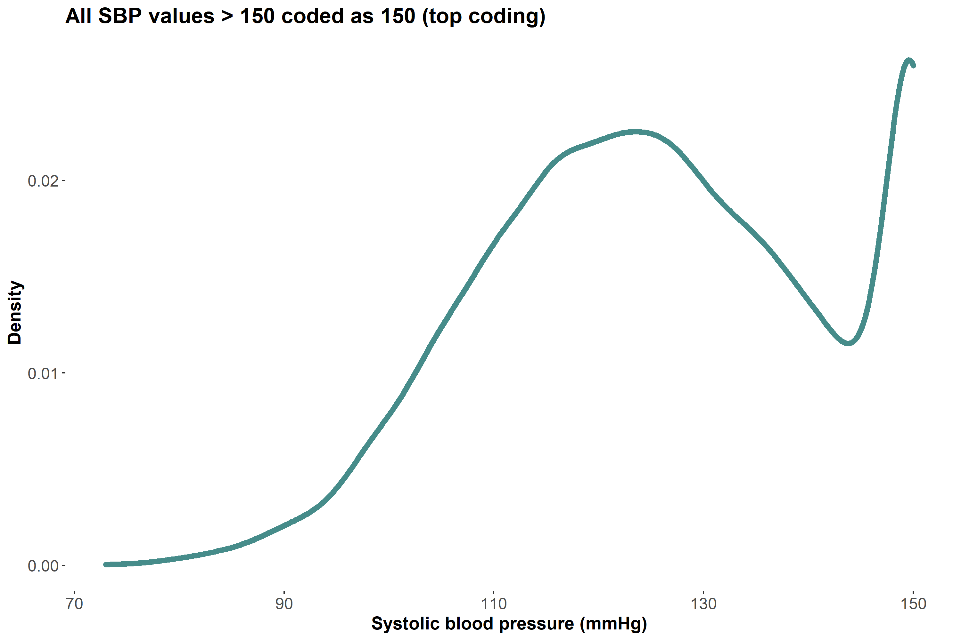
Robust quantiles: Most quantiles unaffected by top/bottom coding💪🏾💪🏼💪🏾

Slide 60
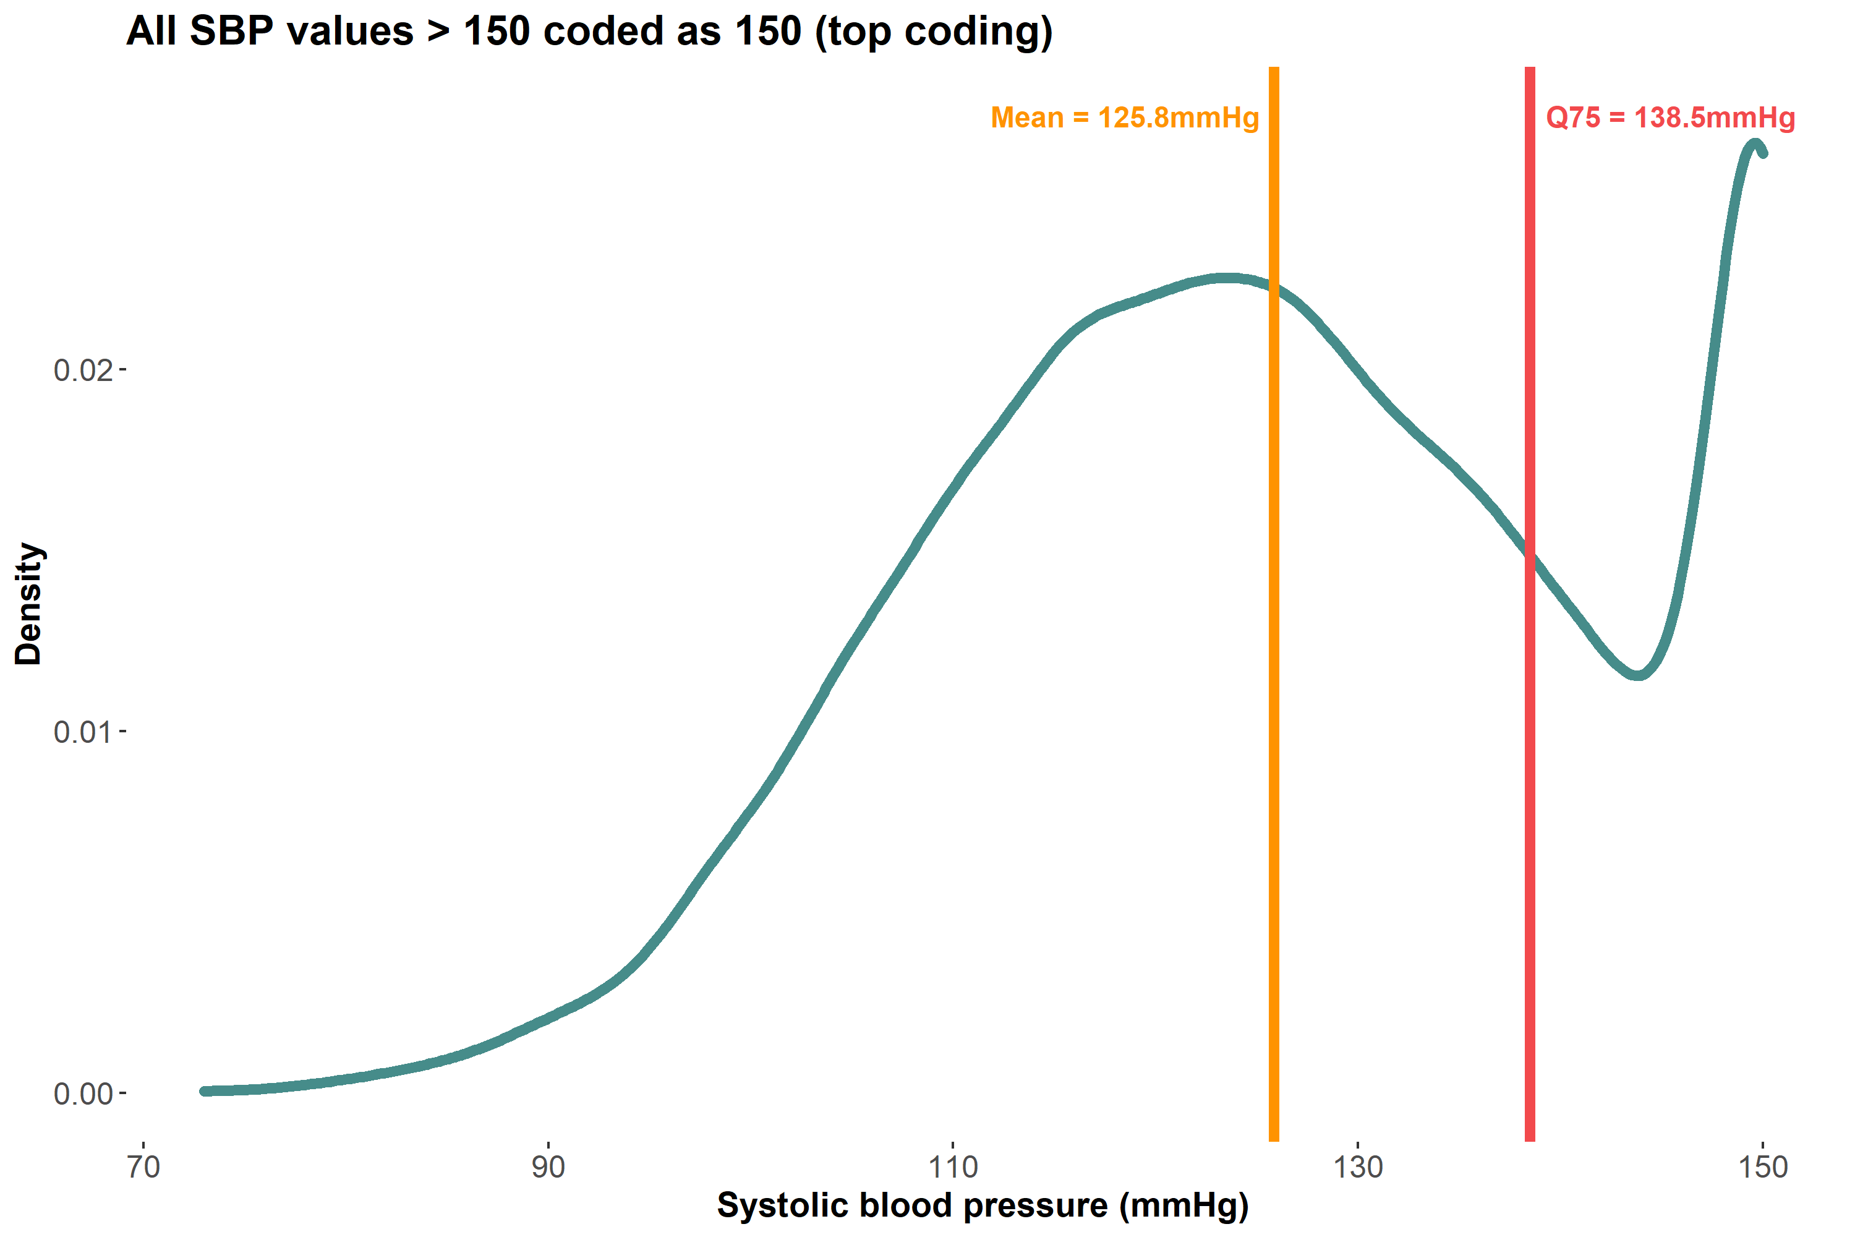
Robust quantiles: Most quantiles unaffected by top/bottom coding 💪🏾💪🏼💪🏾
Mean changed from 127.6mmHg to 125.8mmHg, but the 75th quantile did not change!

Slide 61
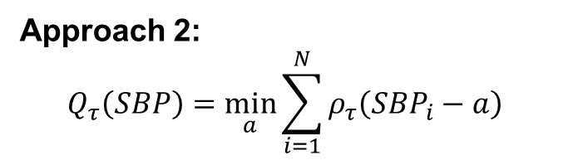
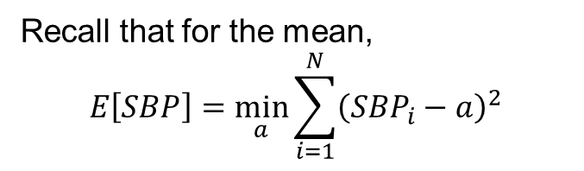
How can we estimate quantiles of the unconditional SBP distribution?
Approach 1:
Sort and arrange all values of SBP
Find the value of SBP such that, say, 50% of the values lie below it
Approach 2:
$$Q_{τ}\left(SBP\right)=\min_{a}{\sum_{i=1}^{N}{ρ_{τ}\left(SBP_{i}−a\right)}}$$
Recall that for the mean,
$$E\left[SBP\right]=\min_{a}{\sum_{i=1}^{N}{{\left(SBP_{i}−a\right)}^{2}}}$$

Slide 62
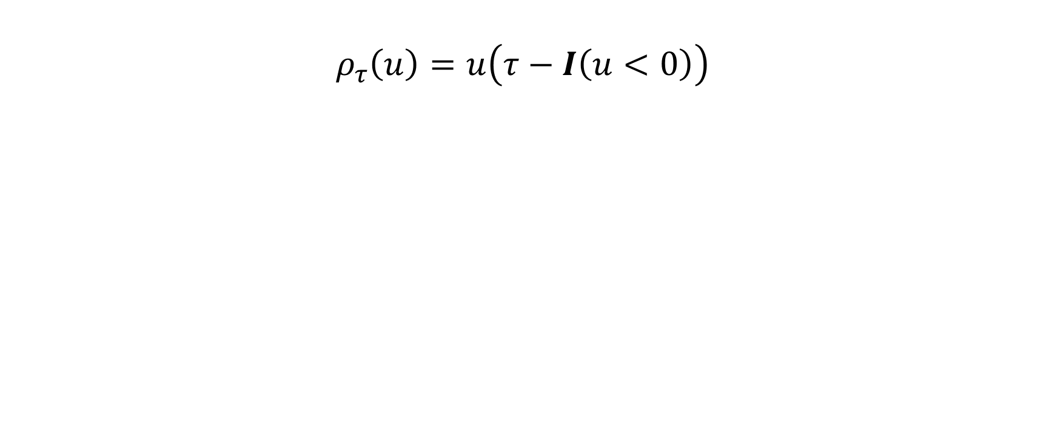
Rho rho rho your boat
$$ρ_{τ}\left(u\right)=u\left(τ−I\left(u<0\right)\right)$$

Slide 63
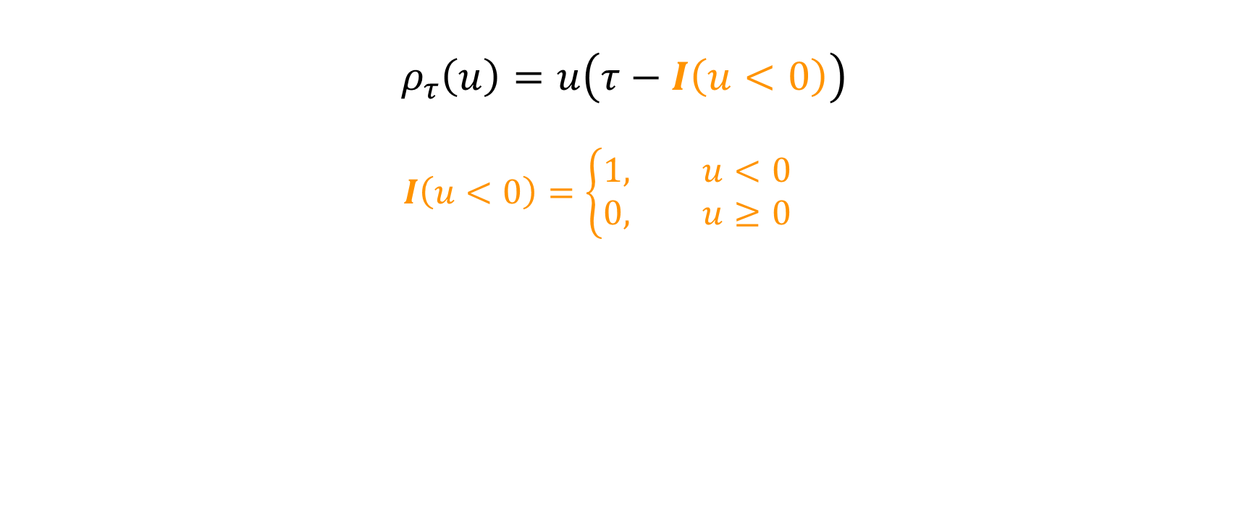
Rho rho rho your boat
$$ρ_{τ}\left(u\right)=u\left(τ−I\left(u<0\right)\right)$$
$$I\left(u<0\right)=\left\{\begin{aligned}1, u<0 \\ &0, u≥0\end{aligned}\right.$$

Slide 64
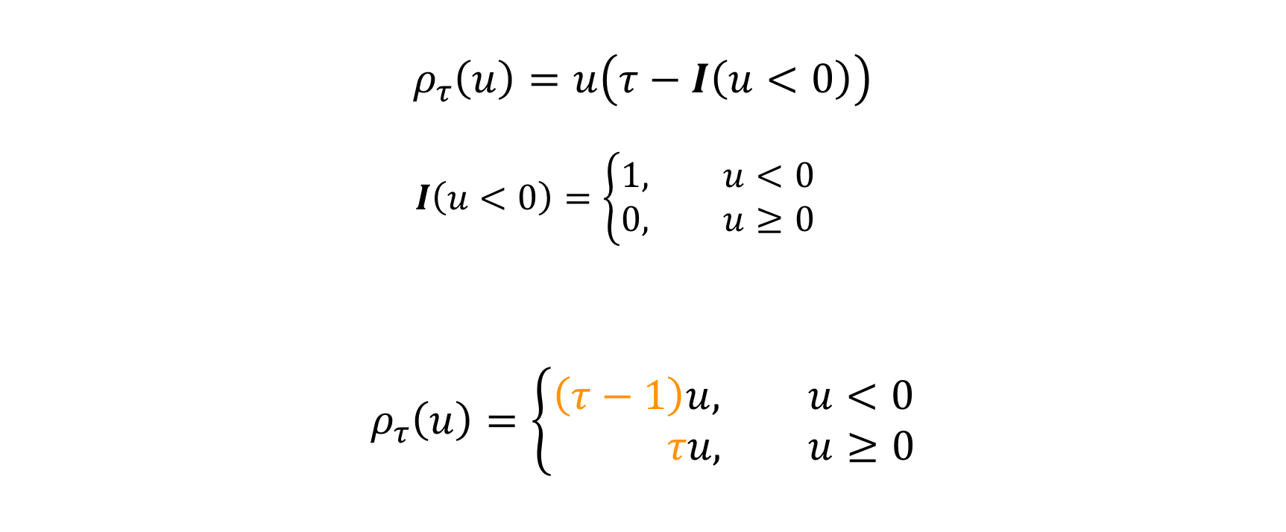
Rho rho rho your boat
$$ρ_{τ}\left(u\right)=u\left(τ−I\left(u<0\right)\right)$$
$$I\left(u<0\right)=\left\{\begin{aligned}1, u<0 \\ &0, u≥0\end{aligned}\right.$$
$$ρ_{τ}\left(u\right)=\left\{\begin{aligned}\left(τ−1\right)u, u<0 \\ & τu, u≥0\end{aligned}\right.$$
$$=\left(1−τ\right)I\left(u<0\right)\left|u\right|+τI\left(u≥0\right)|u|$$

Slide 65
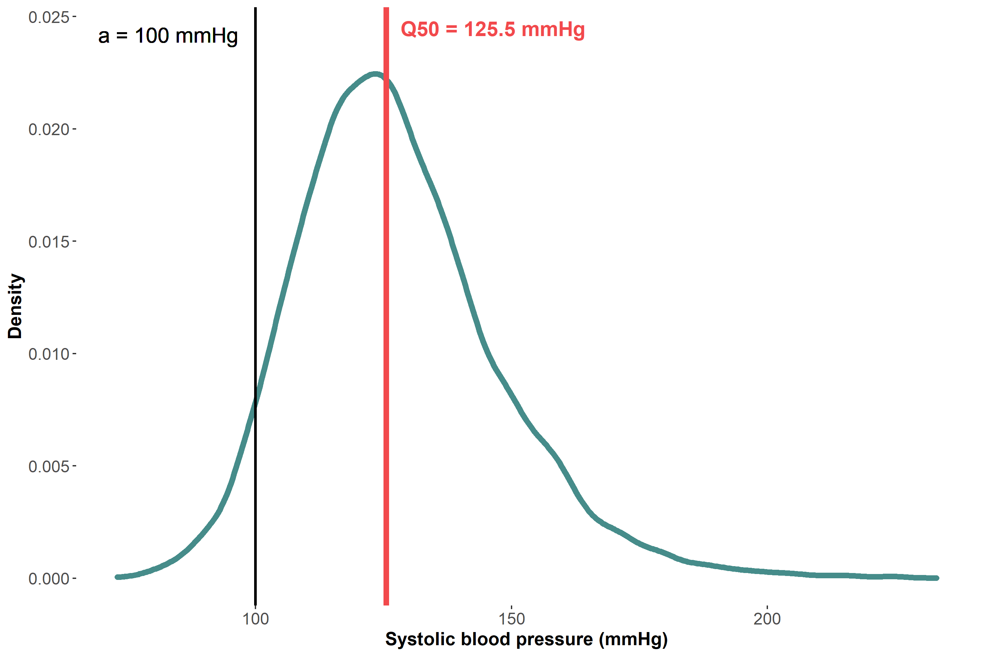
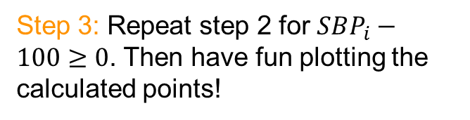

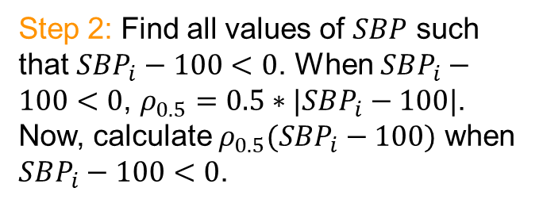
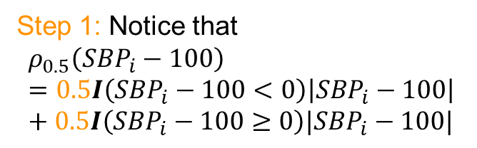

Visualizing $ρ_{0.5}\left(SBP_{i}−a\right)$
Suppose $τ=0.5$and $a=100$. How can we plot $ρ_{0.5}\left(SBP_{i}−100\right)?$
Step 1: Notice that
$$ρ_{0.5}\left(SBP_{i}−100\right)=0.5I\left(SBP_{i}−100<0\right)\left|SBP_{i}−100\right|+0.5I\left(SBP_{i}−100≥0\right)|SBP_{i}−100|$$
Step 2: Find all values of $SBP$ such that $SBP_{i}−100<0$. When $SBP_{i}−100<0$, $ρ_{0.5}=0.5∗|SBP_{i}−100|$. Now, calculate $ρ_{0.5}(SBP_{i}−100)$ when $SBP_{i}−100<0$.
Step 3: Repeat step 2 for $SBP_{i}−100≥0$. Then have fun plotting the calculated points!

Slide 66
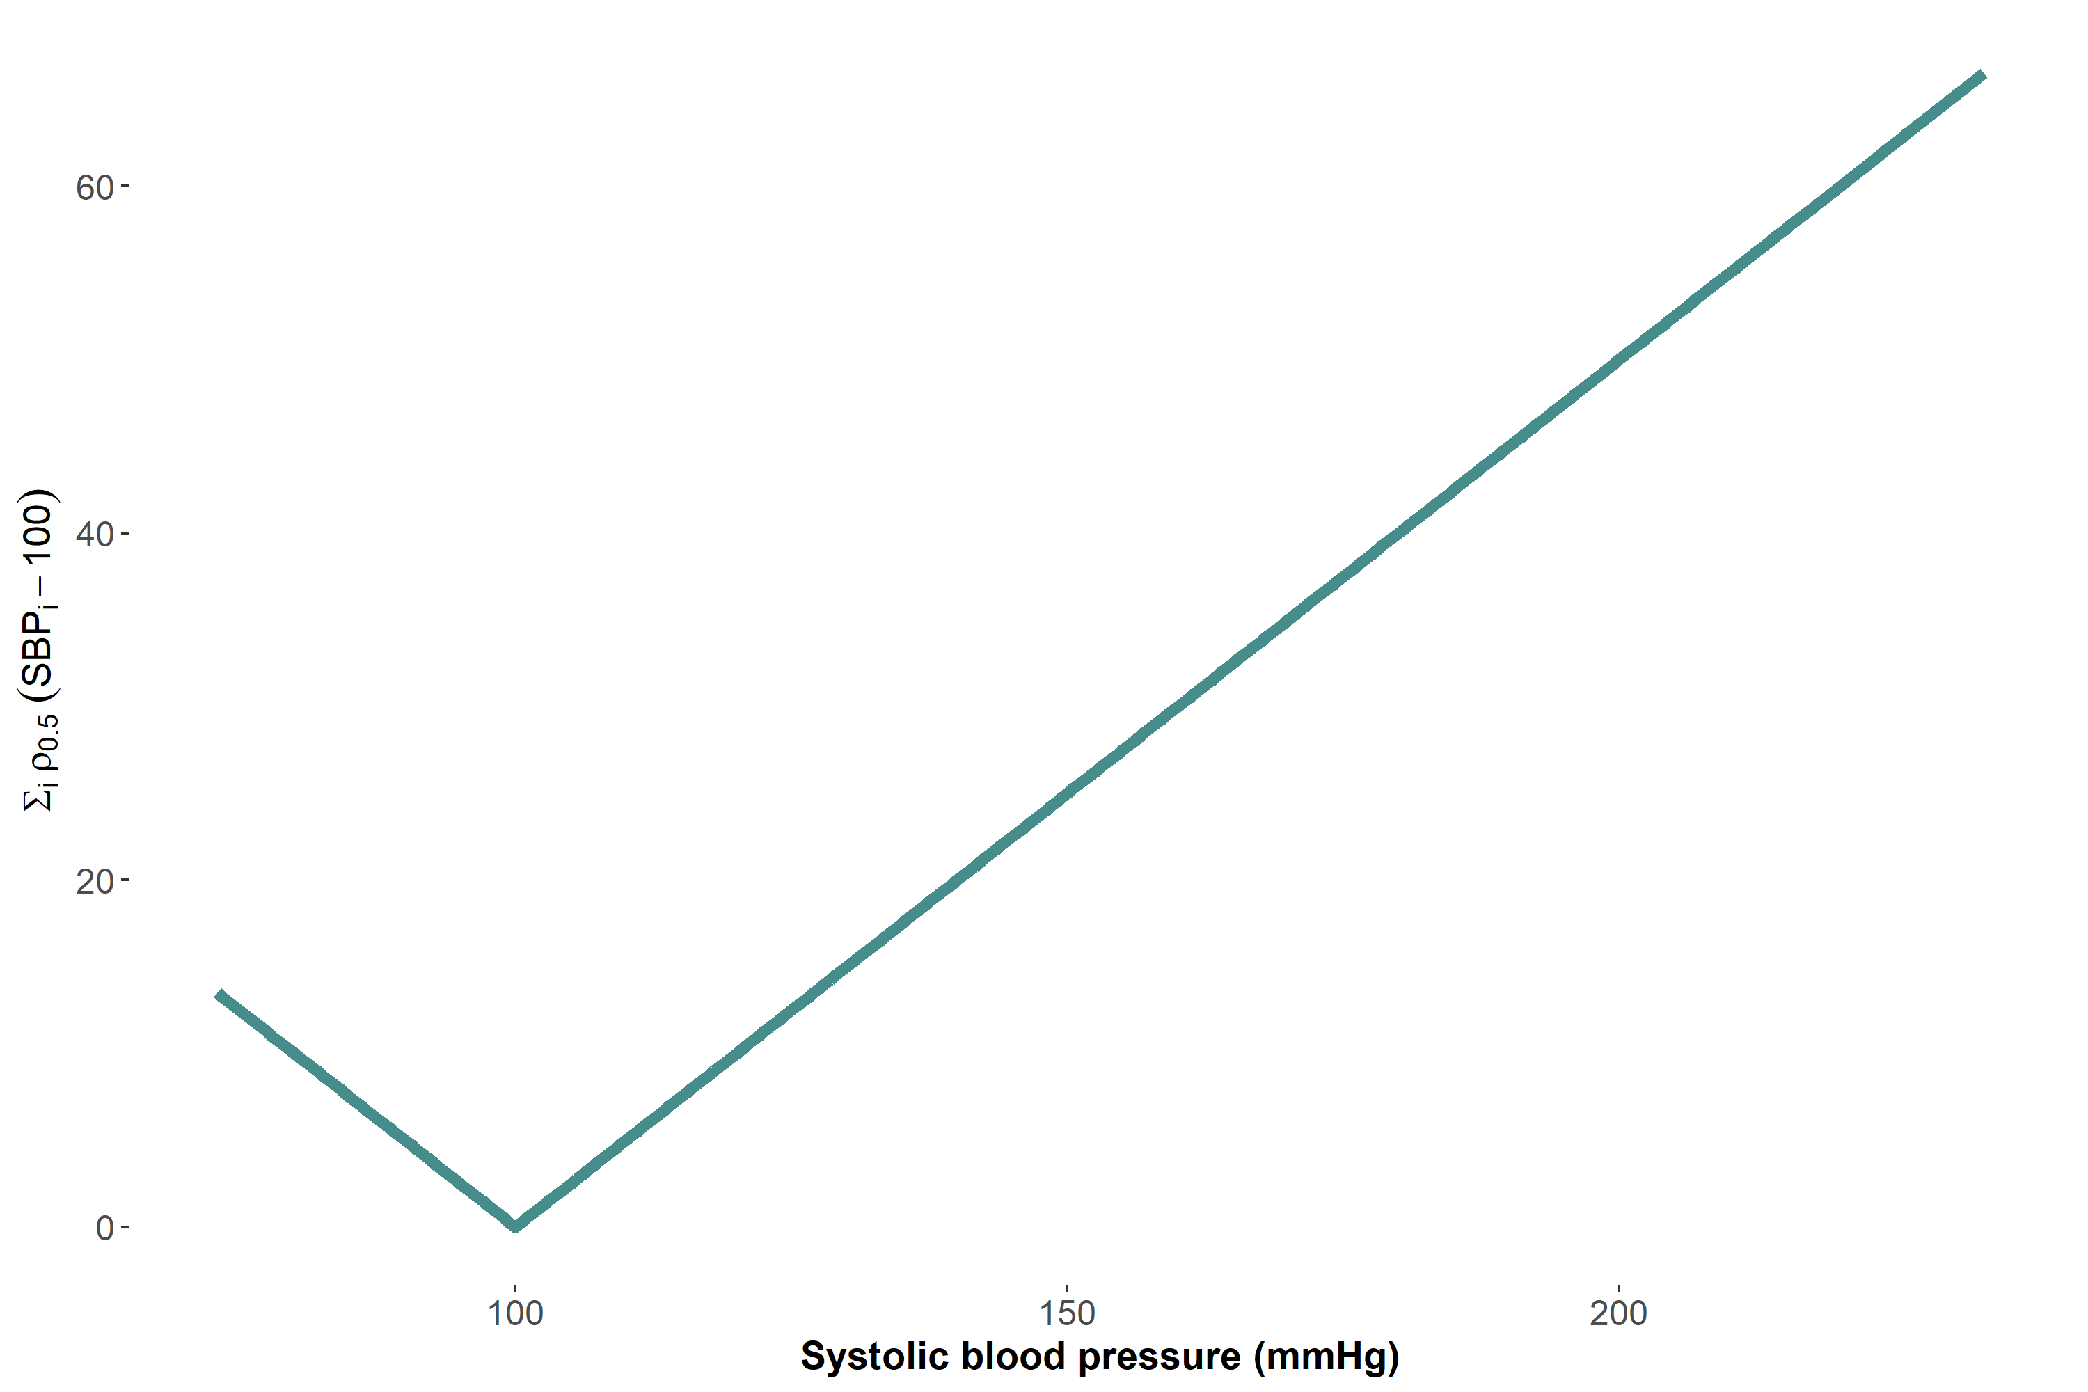

Choose $a=100$. Now let’s plot $ρ_{0.5}\left(SBP_{i}−100\right)$
Slope = 0.5

Slide 67
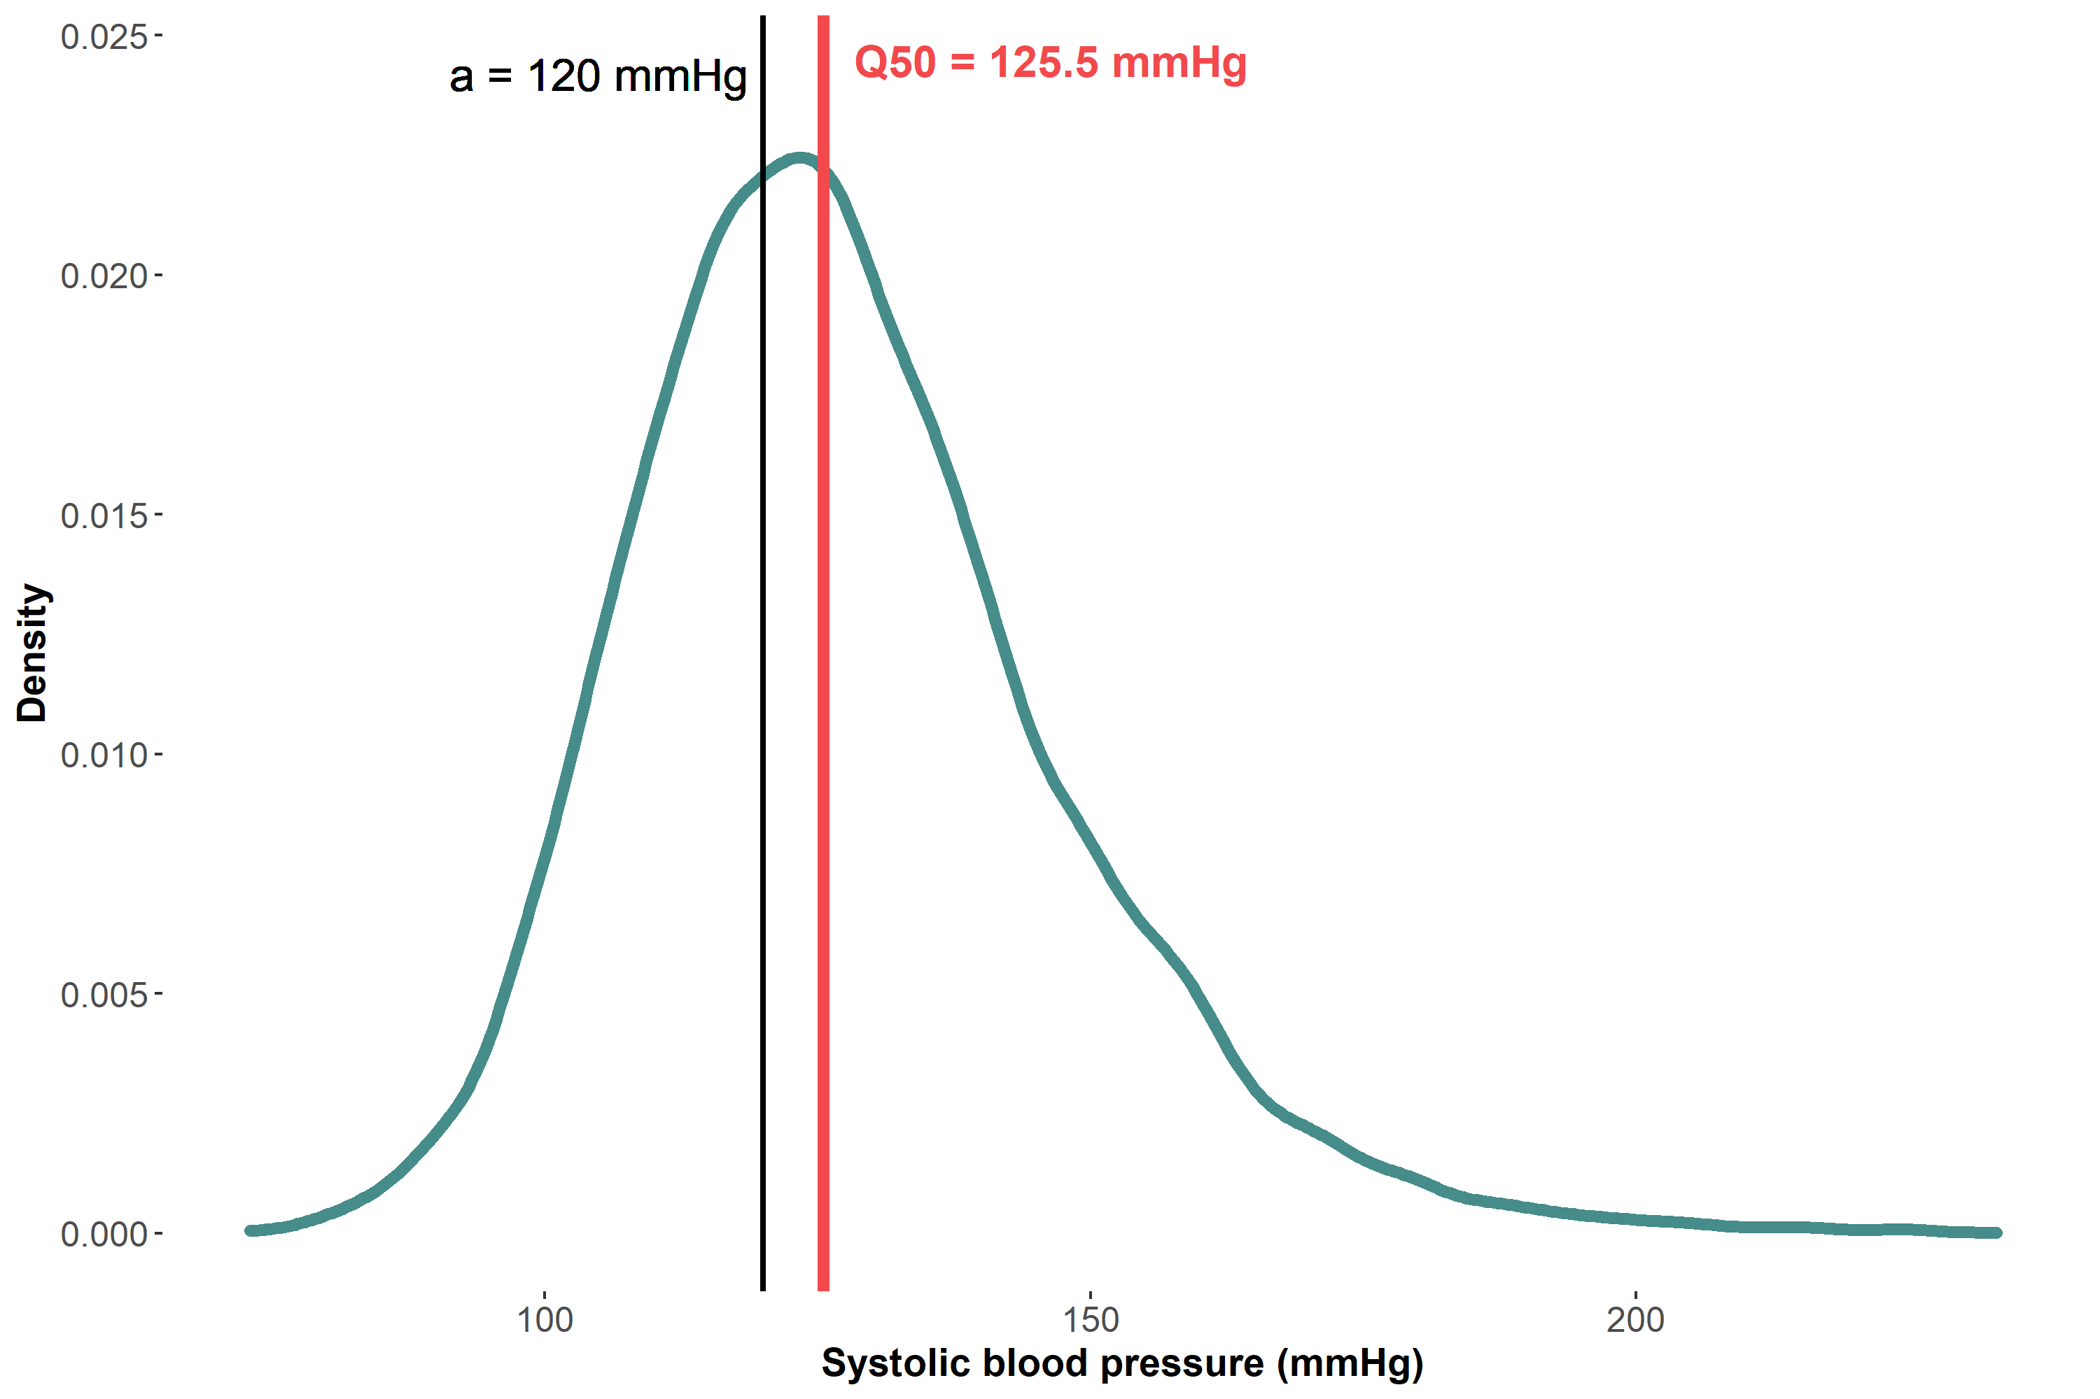
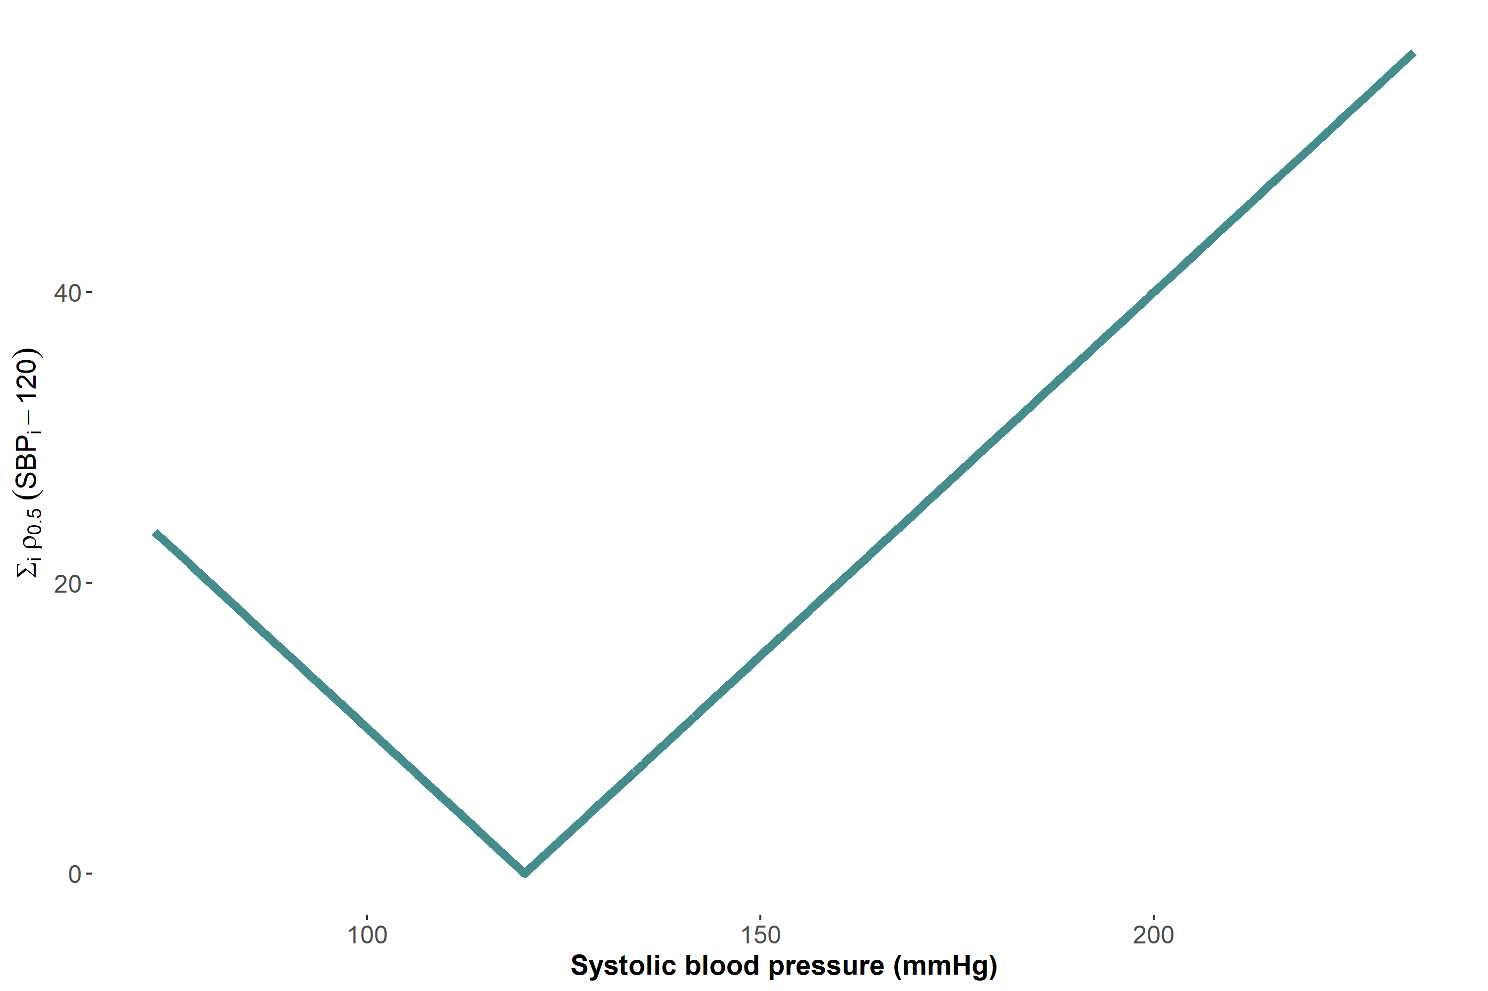

Choose $a=120$. Now let’s plot $ρ_{0.5}\left(SBP_{i}−120\right)$
Slope = 0.5

Slide 68
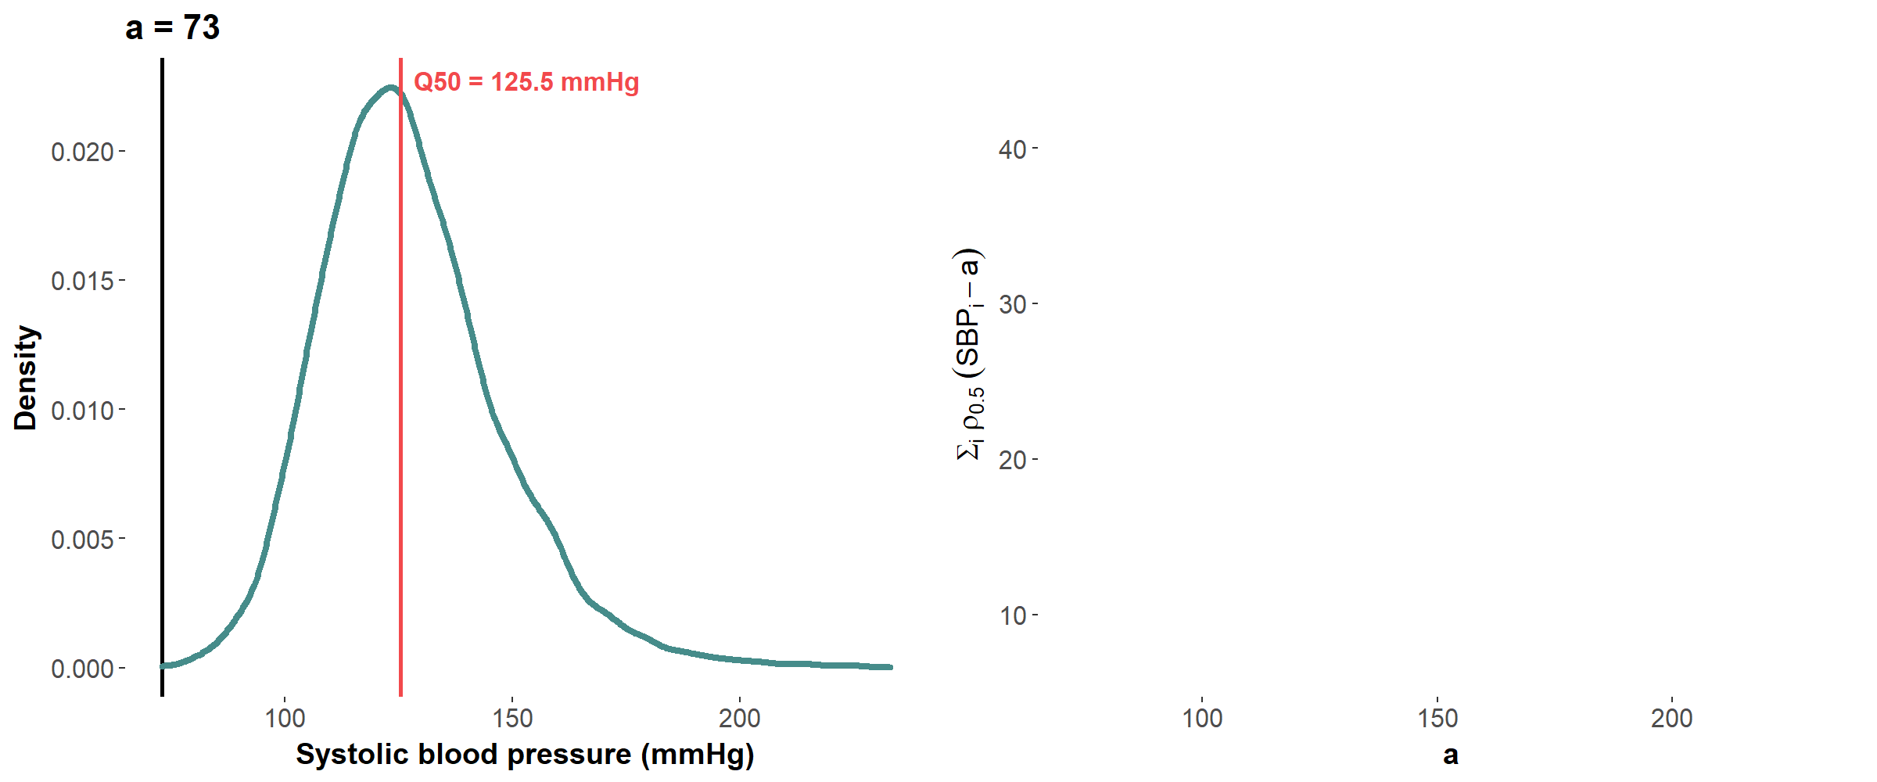

Visualizing the minimization for the median $\min_{a}{0.5\sum_{i=1}^{N}{|SBP_{i}−a|}}$

Slide 69
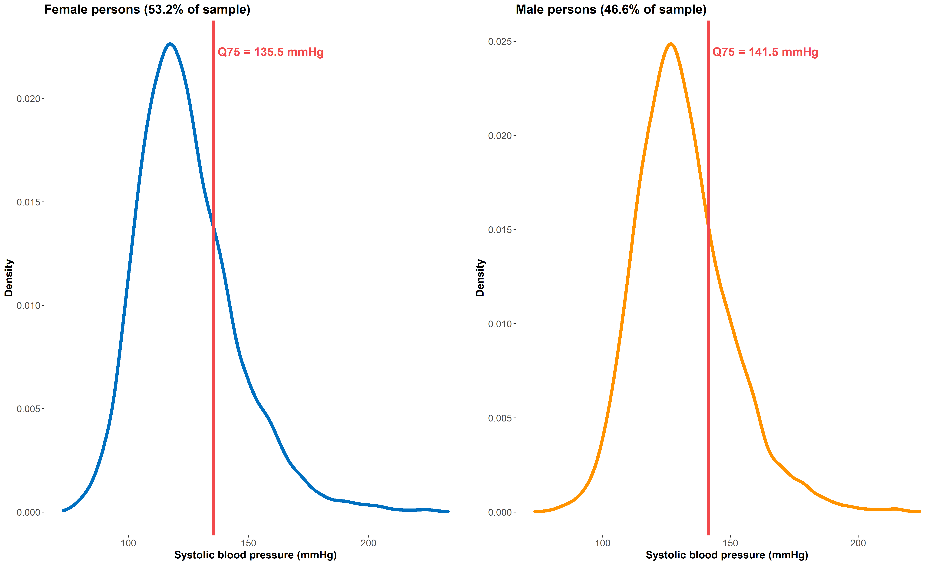
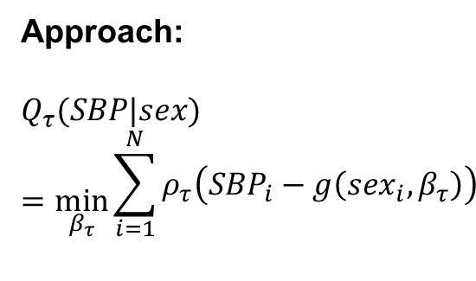
Quantiles of the SBP distribution conditional on sex
Approach:
$$Q_{τ}(SBP|sex)=\min_{β_{τ}}{\begin{aligned}\sum_{i=1}^{N}{ρ_{τ}\left(SBP_{i}−g\left(sex_{i},β_{τ}\right)\right)} \\ \end{aligned}}$$

Slide 70
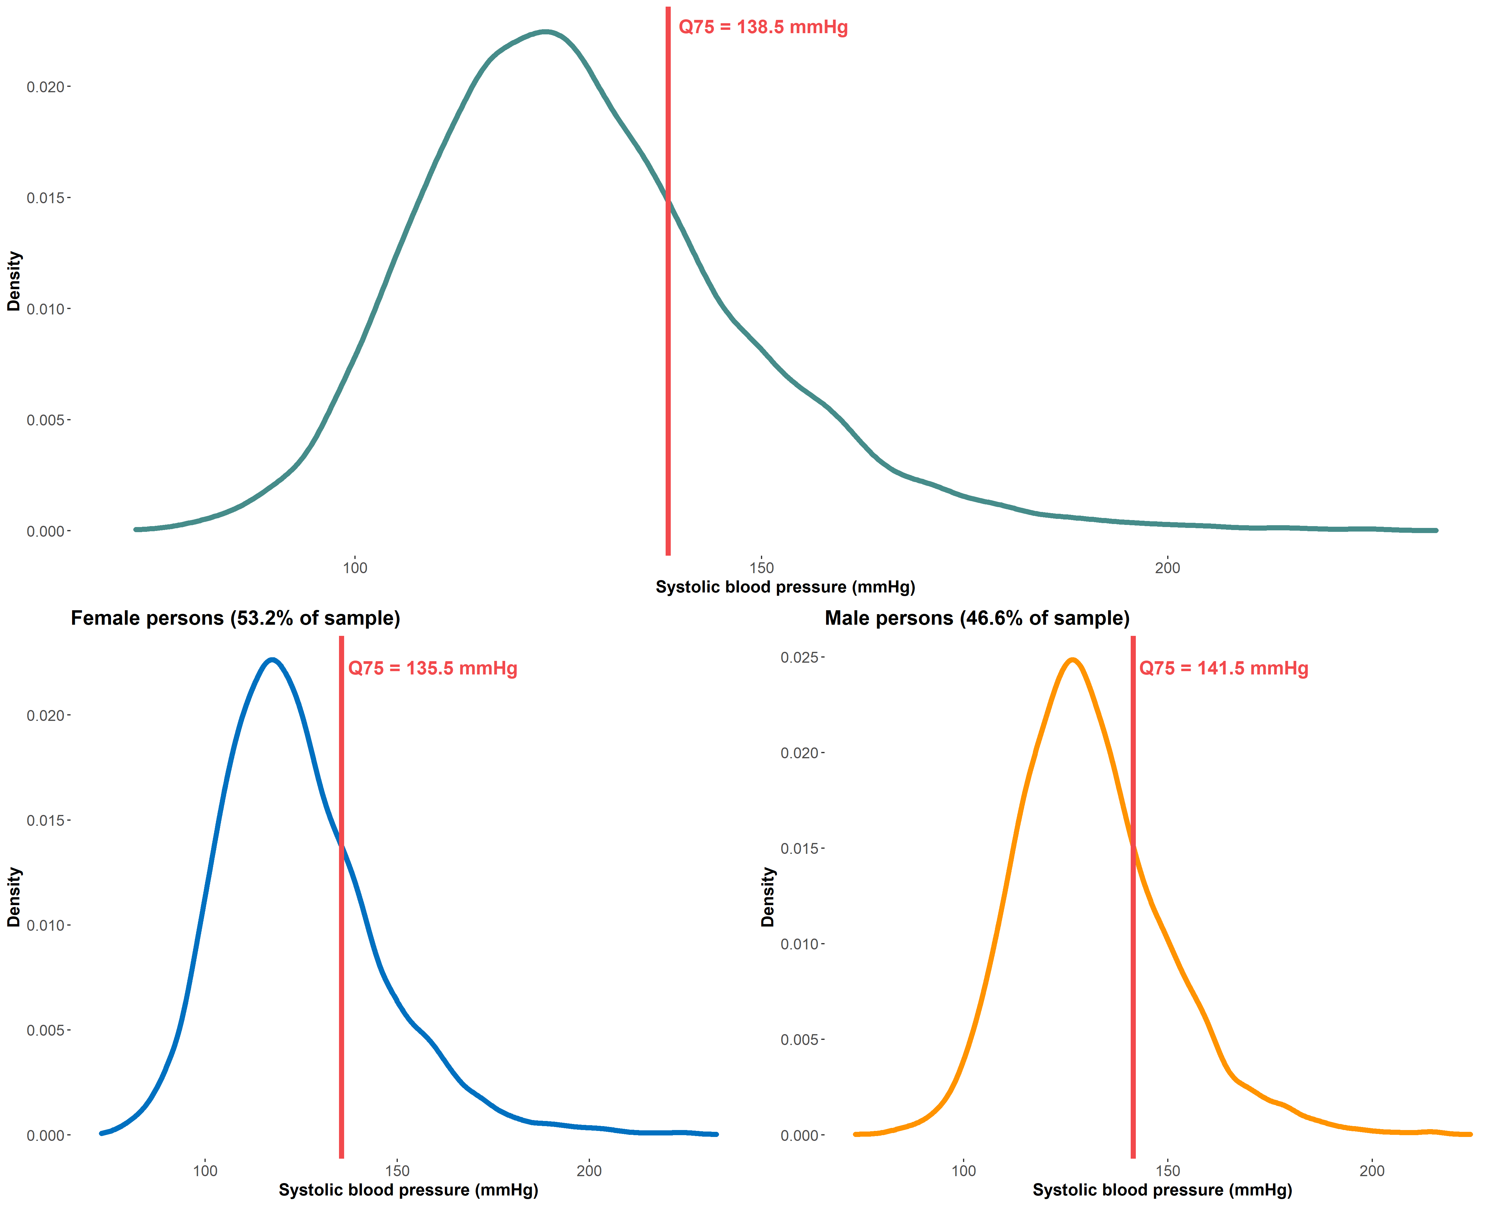
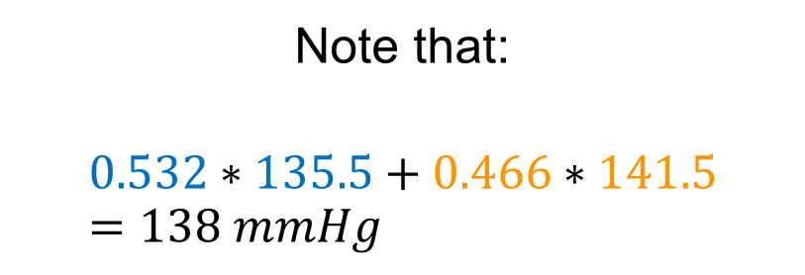
Law of Iterated Quantiles, where art thou?
The Law of Iterated Quantiles does not exist (yet)
Note that:
$$0.532∗135.5+0.466∗141.5=138 mmHg$$
Which is close to the Q75 value in the unconditional distribution but not exact

Slide 71
The lack of a Law of Iterated Quantiles means that we usually cannot use information about quantiles in the conditional distribution to learn about the same quantiles in the unconditional distribution

Slide 72
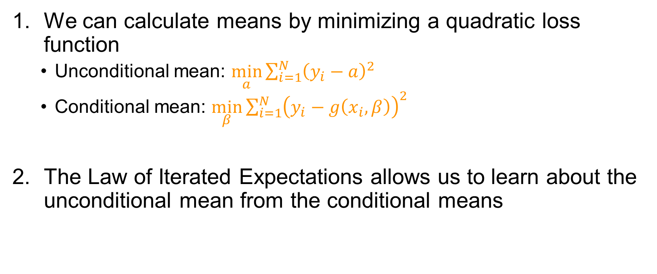
Key takeaways: Means
We can calculate means by minimizing a quadratic loss function
Unconditional mean: $\min_{a}{\sum_{i=1}^{N}{{\left(y_{i}−a\right)}^{2}}}$
Conditional mean: $\min_{β}{\sum_{i=1}^{N}{{\left(y_{i}−g\left(x_{i},β\right)\right)}^{2}}}$
The Law of Iterated Expectations allows us to learn about the unconditional mean from the conditional means

Slide 73

Key takeaways: Quantiles
The $τ^{th}$ quantile is the value of a random variable such that $τ\%$ of the random variable lies below that value
We can calculate quantiles by minimizing the check function
Unconditional quantile: $\min_{a}{\sum_{i=1}^{N}{ρ_{τ}(y_{i}−a)}}$
Conditional quantile: $\min_{β_{τ}}{\sum_{i=1}^{N}{ρ_{τ}\left(y_{i}−g\left(x_{i}, β_{τ}\right)\right)}}$
There is no “Law of Iterated Quantile” (yet)
Need to be clear about whether unconditional or conditional quantiles are of interest

Slide 74
10-minute break

Slide 75
The tyranny of l’homme moyen
i.e., a review of linear regression

Slide 76
Learning aims
Linear regression and the conditional expectation function
Estimating coefficients and standard errors in linear regression
Interpreting linear regression results

Slide 77

Objective: Quantify the association of education with SBP

Slide 78

Potential solution: lm(sbp ~ schlyrs)

Slide 79
But what exactly is linear regression modeling?

Slide 80


Slide 81
Imagine that this figure presents SBP data for the whole population

Slide 82

Calculate mean SBP by education level (i.e., the conditional expectation)

Slide 83

Conditional expectation function (CEF) links the conditional means

Slide 84
The Conditional Expectation Function tells us how the conditional mean of the outcome changes as we change values of conditioning variable

Slide 85

Population regression line ≈ CEF

Slide 86

$$E\left[SBP | schlyrs\right]=β_{0}+β_{1}schlyrs_{i}$$

Slide 87
Linear regression in sample ≈ population regression line ≈ CEF

Slide 88
Since it is a model of the conditional expectation function, linear regression provides us with an estimate for how the mean of the outcome changes as we change the exposure by one unit

Slide 89
In the context of our example, linear regression answers the question: By how much does mean SBP change for each additional year of schooling?

Slide 90
How do we estimate the coefficients of a linear regression?

Slide 91

Our model of the world
Imagine that our model of the world (i.e., the data generating process or DGP) is:
$$y_{i}=β_{0}+β_{1}x_{i}+ε_{i}$$
$$∴ε_{i}=y_{i}−β_{0}−β_{1}x_{i}$$
So, in the case of our empirical example, our model is:
$$SBP_{i}=β_{0}+β_{1}schlyrs_{i}+ε_{i}$$
Notes:
Say our model is:
$$y_{i}=β_{0}+β_{1}x_{i}+ε_{i}$$
Error
$$ε_{i}=y_{i}−β_{0}−β_{1}x_{i}$$
Population regression line:
$$E\left[Y | X\right]=β_{0}+β_{1}X$$
Here we assume that,
$$E\left[ε | X\right]=0$$
Minimize the sum of squared errors
$$\min_{}{\sum_{i}{ε_{i}^{2}}⇒\min_{β_{0},β_{1}}{\sum_{i}{{\left(y_{i}−β_{0}−β_{1}x_{i}\right)}^{2}}}}$$
But, we only have sample data
In our sample,
Residual ~ error
And we estimate the parameters of the regression line by minimizing the sum of squared residuals
$$\min_{}{\sum_{i=1}^{N}{{\hat{ε_{i}}}^{2}}⇒\min_{α_{0},α_{1}}{\sum_{i=1}^{N}{{\left(y_{i}−α_{0}−α_{1}x_{i}\right)}^{2}}}}$$
Show solutions but not the derivation

Slide 92

Population regression line ≈ CEF
Recall that the population regression line is a model of the CEF
$$E\left[Y | X\right]=β_{0}+β_{1}x_{i}$$
Here, we make two key assumptions about the error
$$E\left[ε | X\right]=0⇒E\left[ε\right]=0$$
$$Var\left(ε | X\right)=Var\left(ε\right)=σ^{2}$$

Slide 93

Coefficients of the population regression line
We can calculate the coefficients of the population regression line by minimizing the sum of squared errors
$$\left(β_{0},β_{1}\right)=\min_{}{\sum_{i}{ε_{i}^{2}}}=\min_{β_{0},β_{1}}{\sum_{i}{{\left(y_{i}−β_{0}−β_{1}x_{i}\right)}^{2}}}$$
Notice that this is how we find the conditional expectation!
$$E\left[Y | X\right]=\min_{β}{\sum_{i}{{\left(y_{i}−g\left(x_{i},β\right)\right)}^{2}}}$$

Slide 94

We don’t have the population, only a sample
In our sample, our regression of interest is
$$\hat{E[Y|X]}=\hat{β_{0}}+\hat{β_{1}}x_{i}$$
Where the (“hat”) indicates that we are estimating the population quantities

Slide 95
Coefficients of the sample linear regression
There are several ways to estimate coefficients of the sample linear regression
Ordinary Least Squares
Moment estimator
Maximum likelihood estimator
We will describe Ordinary Least Squares

Slide 96

Ordinary Least Squares (OLS)
We could write the linear regression model as
$$\hat{E[Y|X]}=X^{′}\hat{β}$$
Where $X$ is a matrix of independent variables and $\hat{β}$ is a vector of coefficients
Minimize our estimate of the sum of squared errors, that is
$$\min_{\hat{β}}{\sum_{i=1}^{N}{{\left(Y−X^{′}\hat{β}\right)}^{2}}}⇒\hat{β}={\left(X^{′}X\right)}^{−1}(X^{′}Y)$$

Slide 97

Interpreting coefficients of a simple linear regression
$$\hat{E[Y|X]}=\hat{β_{0}}+\hat{β_{1}}x_{i}$$
$\hat{β_{0}}$ is the estimated average value of $Y$ when $x_{i}=0$ (i.e., the mean of the distribution $Y|x_{i}=0$)
$\hat{β_{1}}$ is the estimated change in the conditional mean of $Y$ for a one-unit change in $X$

Slide 98
How do we estimate standard errors in linear regression?

Slide 99

Standard assumption about the error variance
Homoskedasticity: $Var\left(ε | X\right)=Var\left(ε\right)=σ^{2}$
When the error term is homoscedastic, $se\left(\hat{β}\right)=σ^{2}{\left(X^{′}X\right)}^{−1}$
Yet, homoskedasticity is almost always violated in practice
Heteroskedasticity: error variance depends on the covariates
Correlated outcomes over time in longitudinal, survival, or time series data
Clustered data due to sampling strategy or treatment assignment mechanism
Notes:
Case 1: Homoskedasticity
Sigma^2/Var(X) = standard error for alpha_1
Case 2: Heteroskedasticity

Slide 100

Let’s talk about heteroskedasticity
In a heteroskedastic world,
$$Var\left(ε|X\right)≠σ^{2}$$
The variance of the error term depends on the value of covariates included in the regression
That is, the errors are independent but not identically distributed

Slide 101
A heteroskedastic world

Slide 102

Robust standard errors 💪🏼💪🏾💪🏼
$\text{Estimate} \text{heteroskedasticity} \text{robust} \text{standard} \text{errors} \text{of} \text{our} \text{sample} \text{linear} \text{regression} \text{coefficients} \text{as}$
$$se\left(\hat{β}\right)={\left(X^{′}X\right)}^{−1}X^{′} Ω X{\left(X^{′}X\right)}^{−1}$$
Where $Ω=\left[\begin{matrix}σ_{1}^{2} & 0 & ⋯ & 0 \\ 0 & σ_{2}^{2} & ⋯ & 0 \\ ⋮ & 0 & ⋱ & ⋮ \\ 0 & ⋯ & ⋯ & σ_{n}^{2}\end{matrix}\right]$ $=\left[\begin{matrix}V(ε_{1}) & 0 & ⋯ & 0 \\ 0 & V(ε_{2}) & ⋯ & 0 \\ ⋮ & 0 & ⋱ & ⋮ \\ 0 & ⋯ & ⋯ & V(ε_{n})\end{matrix}\right]$

Slide 103

Robust standard errors 💪🏼💪🏾💪🏼
We can use residuals to estimate the variance-covariance matrix
$$\hat{Ω}=\left[\begin{matrix}{\hat{ε_{1}}}^{2} & 0 & ⋯ & 0 \\ 0 & {\hat{ε_{2}}}^{2} & ⋯ & 0 \\ ⋮ & 0 & ⋱ & ⋮ \\ 0 & ⋯ & ⋯ & {\hat{ε_{n}}}^{2}\end{matrix}\right]=\left[\begin{matrix}{\left(y_{1}−\hat{y_{1}}\right)}^{2} & 0 & ⋯ & 0 \\ 0 & {\left(y_{2}−\hat{y_{2}}\right)}^{2} & ⋯ & 0 \\ ⋮ & 0 & ⋱ & ⋮ \\ 0 & ⋯ & ⋯ & {\left(y_{n}−\hat{y_{n}}\right)}^{2}\end{matrix}\right]$$
Then we plug-and-chug
$$\hat{se\left(\hat{β}\right)}=\frac{N}{N−k}{\left(X^{′}X\right)}^{−1}X^{′} \hat{Ω} X{\left(X^{′}X\right)}^{−1}$$

Slide 104
Time for R

Slide 105
Key takeaways
Linear regression approximates the CEF
Coefficients can be interpreted as the change in the slope of the CEF for a unit change in the exposure
Analytic solution exists to estimating linear regression coefficients
Violations of independent and identically distributed errors assumption can be accounted for in estimating standard errors

Slide 106
30-minute break

Slide 107
Fighting the tyranny of l’homme moyen
i.e., a gentle introduction to conditional quantile regression

Slide 108
Learning aims
Conditional quantile regressions (CQR) and the conditional quantile function
Estimating coefficients and standard errors in CQR
Interpreting CQR results

Slide 109
The CEF told us how the conditional mean of SBP changes as schooling increases

Slide 110

Imagine that we calculated the conditional median instead

Slide 111

Conditional quantile function (CQF) at the 50th quantile

Slide 112
The Conditional Quantile Function at the 50th quantile tells us how the median of the conditional outcome distribution changes as we change values of conditioning variable

Slide 113

Now imagine that we calculated the conditional 75th quantile

Slide 114

CQF at the 75th quantile

Slide 115

All together!
$$E[SBP|schlyrs]$$

Slide 116


All together!
$$Q_{0.5}\left(SBP | schlyrs\right)$$

Slide 117


All together!
$$Q_{0.75}\left(SBP | schlyrs\right)$$

Slide 118
Just as linear regression models the conditional expectation function, conditional quantile regression models the conditional quantile function

Slide 119


$$Q_{0.5}(SBP|schlyrs)=α_{0, 0.5}+α_{1, 0.5}schlyrs_{i}$$

Slide 120


$$Q_{0.75}(SBP|schlyrs)=α_{0, 0.75}+α_{1, 0.75}schlyrs_{i}$$

Slide 121


$$Q_{0.25}(SBP|schlyrs)=α_{0, 0.25}+α_{1, 0.25}schlyrs_{i}$$

Slide 122

CQR in sample ≈ population CQR line ≈ CQF
$$Q_{0.75}\left(SBP | schlyrs_{i}\right)=α_{0, 0.75}+α_{1, 0.75}schlyrs_{i}$$
$$Q_{0. 5}\left(SBP | schlyrs\right)=α_{0, 0.5}+α_{1, 0.5}schlyrs_{i}$$
$$Q_{0. 25}\left(SBP | schlyrs\right)=α_{0, 0.25}+α_{1, 0.25}schlyrs_{i}$$

Slide 123

Since it is a model of the conditional quantile function, conditional quantile regression models how the $τ^{th}$ quantile of the outcome changes as we change the exposure by one unit

Slide 124

In the context of our example, conditional quantile regression answers the question: By how much does the $τ^{th}$ quantile of SBP change for each additional year of schooling?

Slide 125
Why should we care about conditional quantile regression?

Slide 126

Quantile regressions can quantify distributional effects

Slide 127

Quantile regressions can quantify distributional effects
Linear regression

Slide 128

Quantile regressions can quantify distributional effects
CQR at 90th quantile
CQR at 10th quantile

Slide 129
Quantile regressions are robust 💪🏾💪🏼💪🏾
Quantile regressions are usually robust to:
Outliers in the outcome
Monotonic transformation of the outcome (e.g., natural log)
Top coded or bottom coded outcomes

Slide 130
How do we estimate coefficients of a conditional quantile regression?

Slide 131



Koenker and Bassett (1978). Regression Quantiles. Econometrica 46(1): 33-50
Roger Koenker. Source: link
Gilbert Bassett, Jr. Source: link
Notes:
Over 17k citations

Slide 132

Population CQR line ≈ CQF
Recall that the population CQR line is a model of the CQF for the $τ^{th}$ quantile, where $τ∈(0,1)$
$$Q_{τ}(Y|X)=β_{0,τ}+β_{1,τ}x_{i}$$
Here, we assume that
$$Q_{τ}\left(ε | X\right)=0$$

Slide 133

Coefficients of the population CQR line
Calculate the coefficients of the population CQR by minimizing the sum of asymmetrically weighted absolute errors (i.e., $ρ_{τ}(ε_{i})$)
$$\left(β_{0,τ},β_{1,τ}\right)=\min_{}{\sum_{i}{ρ_{τ}(ε_{i})}}=\min_{β_{0,τ},β_{1,τ}}{\sum_{i}{ρ_{τ}(y_{i}−β_{0,τ}−β_{1,τ}x_{i})}}$$
Notice that this is how we find the conditional quantiles!
$$Q_{τ}(Y|X)=\min_{β_{τ}}{\sum_{i}{ρ_{τ}\left(y_{i}−g\left(x_{i}, β_{τ}\right)\right)}}$$

Slide 134

Estimating CQR coefficients in our sample
We can use estimates of the error term to estimate CQR coefficients
$$\left(\hat{β_{0,τ}},\hat{β_{1,τ}}\right)=\min_{}{\sum_{i}{ρ_{τ}(\hat{ε_{i}})}}=\min_{\hat{β_{0,τ}},\hat{β_{1,τ}}}{\sum_{i}{ρ_{τ}\left(y_{i}−\hat{β_{0,τ}}−\hat{β_{1,τ}}x_{i}\right)}}$$
Unlike OLS, the CQR minimization problem does not have an analytic solution
However, this can be solved using linear programming algorithms!

Slide 135

Interpreting coefficients of a univariate CQR
$$\hat{Q_{τ}(Y|X)}=\hat{β_{0,τ}}+\hat{β_{1,τ}}x_{i}$$
$\hat{β_{0,τ}}$ is the estimated $τ^{th}$ quantile of $Y$ when $x_{i}=0$ (i.e., the $τ^{th}$ quantile of the distribution $Y|x_{i}=0$)
$\hat{β_{1,τ}}$ is the estimated change in the $τ^{th}$ quantile of the conditional distribution of $Y$ for a one-unit change in $X$
If $X=\{0,1\}$, then $\hat{β_{1,τ}}$ is our estimate of the difference in the $τ^{th}$ quantile of $Y$ when $x_{i}=1$ and $x_{i}=0$

Slide 136


Apply caution when interpreting CQR results!
ID | $$Y(x_{i}=0)$$ | $$Y(x_{i}=1)$$
1 | 13 | 4
2 | 14 | 5
3 | 15 | 2
4 | 2 | 8
5 | 5 | 7
6 | 11 | 5
7 | 17 | 3
8 | 6 | 9
9 | 12 | 6
$$\overline{Y(X=x)}$$ | 10.6 | 5.4
Linear regression estimates:
$\overline{Y(x_{i}=1)}−\overline{Y\left(x_{i}=0\right)}$,
$=5.4−10.6=−5.2$.

Slide 137

Apply caution when interpreting CQR results!
ID | $$Y(x_{i}=0)$$ | $$Y(x_{i}=1)$$ | $$Y\left(x_{i}=1\right)−Y(x_{i}=0)$$
1 | 13 | 4 | -9
2 | 14 | 5 | -9
3 | 15 | 2 | -13
4 | 2 | 8 | 6
5 | 5 | 7 | -2
6 | 11 | 5 | -6
7 | 17 | 3 | -14
8 | 6 | 9 | -3
9 | 12 | 6 | 6
$$\overline{Y(X=x)}$$ | 10.6 | 5.4

Slide 138



Apply caution when interpreting CQR results!
ID | $$Y(x_{i}=0)$$ | $$Y(x_{i}=1)$$ | $$Y\left(x_{i}=1\right)−Y(x_{i}=0)$$
1 | 13 | 4 | -9
2 | 14 | 5 | -9
3 | 15 | 2 | -13
4 | 2 | 8 | 6
5 | 5 | 7 | -2
6 | 11 | 5 | -6
7 | 17 | 3 | -14
8 | 6 | 9 | -3
9 | 12 | 6 | 6
$$\overline{Y\left(x_{i}=1\right)−Y(x_{i}=0)}$$ | 10.6 | 5.4 | -5.2
Linear regression estimates:
$\overline{Y(x_{i}=1)}−\overline{Y\left(x_{i}=0\right)}$,
$=5.4−10.6=−5.2$.
Linear regression estimate can be interpreted as average change in $Y$ as an individual goes from $x_{i}=0$ to $x_{i}=1$
Notes:
Should be -6

Slide 139


Apply caution when interpreting CQR results!
Quantile regression at the median estimates:
$Q_{0.5}\left(Y\left(x_{i}=1\right)\right)−Q_{0.5}\left(Y\left(x_{i}=0\right)\right)$,
$=5−12=−7$.
ID | $$Y(x_{i}=0)$$ | $$Y(x_{i}=1)$$
1 | 13 | 4
2 | 14 | 5
3 | 15 | 2
4 | 2 | 8
5 | 5 | 7
6 | 11 | 5
7 | 17 | 3
8 | 6 | 9
9 | 12 | 6
$$Q_{0.5}\left(Y\left(X=x\right)\right)$$ | 12 | 5

Slide 140

Apply caution when interpreting CQR results!
Quantile regression at the median estimates:
$Q_{0.5}\left(Y\left(x_{i}=1\right)\right)−Q_{0.5}\left(Y\left(x_{i}=0\right)\right)$,
$=5−12=−7$.
ID | $$Y(x_{i}=0)$$ | $$Y(x_{i}=1)$$
1 | 13 | 4
2 | 14 | 5
3 | 15 | 2
4 | 2 | 8
5 | 5 | 7
6 | 11 | 5
7 | 17 | 3
8 | 6 | 9
9 | 12 | 6
$$Q_{0.5}\left(Y\left(X=x\right)\right)$$ | 12 | 5
Change in $Y$ as we go from $X=0$ to $X=1$ for the individual at the median under $Y(x_{i}=0)$:
$=6−12=−6$.

Slide 141


Apply caution when interpreting CQR results!
Quantile regression at the median estimates:
$Q_{0.5}\left(Y\left(x_{i}=1\right)\right)−Q_{0.5}\left(Y\left(x_{i}=0\right)\right)$,
$=5−12=−7$.
ID | $$Y(x_{i}=0)$$ | $$Y(x_{i}=1)$$
1 | 13 | 4
2 | 14 | 5
3 | 15 | 2
4 | 2 | 8
5 | 5 | 7
6 | 11 | 5
7 | 17 | 3
8 | 6 | 9
9 | 12 | 6
$$Q_{0.5}\left(Y\left(X=x\right)\right)$$ | 12 | 5
Change in $Y$ as we go from $X=0$ to $X=1$ for the individual at the median under $Y(x_{i}=0)$:
$=6−12=−6$.
Change in $Y$ as we go from $X=0$ to $X=1$ for the individual at the median under $Y(x_{i}=1)$:
$=5−11=−6$.

Slide 142

Conditional quantile regression estimates cannot usually be interpreted as the estimated change in the outcome for an individual at the $τ^{th}$ quantile of the distribution under a specific treatment value

Slide 143
How do we estimate standard errors in conditional quantile regression?

Slide 144

A heteroskedastic world
When the errors are dependent on the covariates, we have a “robust” variance formula
$$V\left({\hat{β}}_{τ}\right)=τ\left(1−τ\right)Q_{τ}^{−1}QQ_{τ}^{−1}$$
Here,
$τ(1−τ)$ is a constant for any given $τ$
$Q=E\left[X^{′}X\right]$
$Q_{τ}=E\left[X^{′}X\right]f_{τ}(0)$

Slide 145

A heteroskedastic world
Notice that in the variance formula we are taking the inverse of $Q_{τ}$
$$V\left(\hat{β_{τ}}\right)=τ\left(1−τ\right)Q_{τ}^{−1}QQ_{τ}^{−1}$$
Since $Q_{τ}=E\left[X^{′}X\right]f_{τ}(0)$, where $f_{τ}(0)$ is low, standard errors are going to be large
In places where the outcome is sparse (usually the tails), standard errors are going to be large

Slide 146
Key criticism of conditional quantile regression is that statistical power is usually a problem at the tails of the outcome distribution, which is substantively of interest

Slide 147
Bootstrapped standard errors
Despite having these various formulas, recommended practice is to bootstrap
In general, bootstrap relies on random resampling with replacement of the observed data and fitting CQR in each sample
Different bootstrap methods available in the R package
Standard non-parametric bootstrap is an estimator for the “robust” CQR standard errors

Slide 148
Time for R

Slide 149

Key takeaways
Just as linear regression models the CEF, CQR models the CQF
The CQF can be defined for any quantile of interest
CQR coefficients can be estimated by minimizing the sum of $ρ_{τ}(.)$, which does not have an analytic solution
Coefficients can be interpreted as the change in the conditional quantile of interest for a unit change in the exposure
CQR standard errors are inversely proportional to the error density, because of which in parts of the outcome distribution where outcome data are sparse, standard errors are larger
Bootstrap is the preferred method of estimating the standard errors

Slide 150
10-minute break

Slide 151
Fighting the tyranny of l’homme moyen: The sequel
i.e., a gentle introduction to unconditional quantile regressions

Slide 152
Learning aims
Counterfactual unconditional distributions and contrasts
Firpo, Fortin, and Lemieux (2009) method of estimating parameters of the unconditional quantile regression
Interpreting unconditional quantile regression results

Slide 153
What if we wanted to learn how the unconditional outcome distribution changed in response to some population-level intervention?

Slide 154
Here’s the unconditional distribution of SBP in our data

Slide 155

Suppose everyone gets an intervention creating a counterfactual SBP distribution

Slide 156

We are interested in the difference in quantiles of these distributions
Estimand = Old Q50 – New Q50

Slide 157
Can we use conditional quantile regressions to estimate contrasts of the unconditional outcome distribution?

Slide 158
Can we use conditional quantile regressions to estimate contrasts of the unconditional outcome distribution? It depends!

Slide 159
According to Borah and Basu (2013)
Conditional quantile regressions quantify contrasts of the unconditional outcome distribution if:
Outcome is only a function of the exposure
Exposure induces only a location shift in the outcome in the presence of other covariates
But not if
Exposure interacts with other covariates in the DGP

Slide 160
Is all hope lost?

Slide 161




Sergio Firpo. Source: link
Nicole Fortin. Source: link
Firpo, Fortin, Lemieux (2009). Unconditional Quantile Regressions. Econometrica 77(3): 953-973
Thomas Lemieux. Source: link

Slide 162

Firpo’s unconditional quantile regression method quantifies the change in the $τ^{th}$ quantile of the unconditional outcome distribution for a small change in the exposure distribution

Slide 163

How does Firpo et. al (2009) quantify the change in the $τ^{th}$ quantile of the unconditional outcome distribution?

Slide 164
Recentered Influence Function (RIF) to the rescue!
Recentered influence function (RIF): sum of a distributional statistic’s influence function and the distributional statistic itself
RIF regression: regression of the RIF on the exposure and other covariates of interest
Effect on quantile of the unconditional outcome distribution for a small shift in the unconditional exposure distribution (i.e., the Unconditional Quantile Partial Effect)
Several methods of estimating RIF regression including OLS
Notes:
Logistic, polynomial

Slide 165
What’s an Influence Function?
Influence functions (IF) are a way of assessing the “robustness” of distributional statistics
IF calculates change in a distributional statistic of interest for a “small” change in the distribution
IF calculates the expected change even when we don’t observe the small change
Examples of distributional statistics include means, quantiles, Gini coefficients, etc.
Each distributional statistic has an influence function specific to it

Slide 166

Influence Function for quantiles
Influence function for the $τ^{th}$ quantile of $Y$
$$IF\left(y;q_{τ}\right)=\frac{τ−I\left(y≤q_{τ}\right)}{f_{y}(q_{τ})}$$
Where $q_{τ}$ is the value of $Y$ at the $τ^{th}$ quantile, $I(.)$ is the indicator function, and $f_{y}(q_{τ})$ is the density of $Y$ at the $τ^{th}$ quantile

Slide 167

What’s a RIF?
Firpo et. al. (2009) define the RIF for the $τ^{th}$ quantile as
$$RIF\left(y;q_{τ}\right)=q_{τ}+IF\left(y;q_{τ}\right)=q_{τ}+\frac{τ−I\left(y≤q_{τ}\right)}{f_{y}(q_{τ})}$$
Expected value of the RIF equals the $τ^{th}$ quantile
$$E\left[RIF\left(y;q_{τ}\right)\right]=E\left[q_{τ}+\frac{τ−I\left(y≤q_{τ}\right)}{f_{y}\left(q_{τ}\right)}\right]=E\left[q_{τ}\right]+E\left[\frac{τ−I\left(y≤q_{τ}\right)}{f_{y}\left(q_{τ}\right)}\right]=q_{τ}$$

Slide 168
How does the Firpo et. al. (2009) method work?

Slide 169
Step 1
Estimate the RIF in the unconditional outcome distribution
Step 2
Regress RIF on exposure + covariates
Step 3
Estimate standard errors using bootstrap or sandwich estimator

Slide 170
Step 1
Estimate the RIF in the unconditional outcome distribution
Step 2
Regress RIF on exposure + covariates
Step 3
Estimate standard errors using bootstrap or sandwich estimator

Slide 171

Step 1: Choose the quantile of interest in the unconditional outcome distribution

Slide 172



Step 1: Estimate the RIF at the quantile of interest
$$RIF\left(SBP_{i};q_{0.25}\right)=q_{0.25}+\frac{τ−I(SBP_{i}≤q_{0.25})}{f_{Y}(q_{0.25})}$$
$$RIF\left(SBP;q_{0.25}\right)=114+\frac{0.25−I(SBP_{i}≤114)}{f_{Y}(114)}$$
$$RIF\left(SBP;q_{0.25}\right)=\left\{\begin{aligned}75.94; I\left(SBP_{i}≤114\right) \\ 126.69; I\left(SBP_{i}>114\right)\end{aligned}\right.$$

Slide 173

Moving from the unconditional distribution to the RIF

Slide 174

Step 1: Estimated RIF at the 25th quantile of SBP
$$RIF(SBP_{i}, q_{0.25})= \left\{\begin{aligned}75.94; I\left(SBP≤114\right) \\ 126.69; I\left(SBP>114\right)\end{aligned}\right.$$
$E\left[RIF\left(SBP_{i},q_{0.25}\right)\right]=\left(0.25\right)\left(75.94\right)+\left(0.75\right)\left(126.69\right)$ $=114 mmHg=q_{0.25}$

Slide 175




Step 1: Estimated RIF at the 25th, 50th, and 75th quantiles of SBP
$$RIF(SBP_{i}, q_{0.25})= \left\{\begin{aligned}75.94; I\left(SBP≤114\right) \\ 126.69; I\left(SBP>114\right)\end{aligned}\right.$$
$$RIF(SBP_{i}, q_{0.5})= \left\{\begin{aligned}103.00; I\left(SBP≤125.5\right) \\ 148.00; I\left(SBP>125.5\right)\end{aligned}\right.$$
$$RIF(SBP_{i}, q_{0.75})= \left\{\begin{aligned}121.65; I\left(SBP≤138.5\right) \\ 189.05; I\left(SBP>138.5\right)\end{aligned}\right.$$

Slide 176
Step 1
Estimate the RIF in the unconditional outcome distribution
Step 2
Regress RIF on exposure + covariates
Step 3
Estimate standard errors using bootstrap or sandwich estimator

Slide 177

Step 2: Three ways to regress RIF on exposure and covariates
$$RIF\left(y;q_{τ}\right)=q_{τ}+\frac{τ−I\left(y≤q_{τ}\right)}{f_{y}(q_{τ})}=\frac{1}{f_{y}\left(q_{τ}\right)}I\left(y>q_{τ}\right)+q_{τ}−\frac{1−τ}{f_{y}\left(q_{τ}\right)}$$
Three ways of regressing RIF on exposure and covariates:
Linear regression using OLS with RIF as the outcome (RIF-OLS)
Logistic regression using $I\left(y>q_{τ}\right)$ as the outcome (RIF-Logit)
Polynomial regression to model $I\left(y>q_{τ}\right)$ (RIF-NP)
We will focus on RIF-OLS as it is easiest and most practical

Slide 178

Step 2: Fitting the RIF-OLS regression for SBP at the 25th quantile
$$E\left[RIF\left(SBP_{i};q_{0.25}\right) | X,C\right]=α_{0,0.25}+α_{1,0.25}x_{i}+λ_{0.25}^{′}C$$
$$E\left[E\left[RIF\left(SBP_{i};q_{0.25}\right) | X,C\right]\right]=E\left[α_{0,0.25}+α_{1,0.25}x_{i}+λ_{0.25}^{′}C\right]$$
$$E\left[RIF(SBP_{i};q_{0.25})\right]=α_{0,0.25}+α_{1,0.25}E\left[X\right]+λ_{0.25}^{′}E[C]$$
$$E\left[RIF(SBP_{i};q_{0.25})\right]=q_{0.25}$$
Notes:
Iterating on the lhs and taking the expectation of rhs

Slide 179

The RIF “trick”
$$RIF(SBP_{i}, q_{0.25})= \left\{\begin{aligned}75.94; I\left(SBP≤114\right) \\ 126.69; I\left(SBP>114\right)\end{aligned}\right.$$
$E\left[RIF\left(SBP_{i},q_{0.25}\right)\right]=\left(0.25\right)\left(75.94\right)+\left(0.75\right)\left(126.69\right)$ $=114 mmHg=q_{0.25}$

Slide 180
Firpo’s method “tricks” a regression model into modeling quantiles of the unconditional outcome distribution by using the recentered influence function as the outcome

Slide 181


Slide 182

Interpreting coefficients of the RIF-OLS model
$$\hat{E\left[RIF(y_{i};q_{τ})\right]}=\hat{α_{0,τ}}+\hat{α_{1,τ}}E\left[X\right]+\hat{λ_{τ}′}E[C]$$
$\hat{α_{1,τ}}$ is the estimated change in the $τ^{th}$ quantile of the unconditional distribution of $Y$ for a unit change in the mean of the unconditional distribution of the exposure $X$

Slide 183

In the context of our example, unconditional quantile regression answers the question: By how much does the $τ^{th}$ quantile of the unconditional SBP distribution change if the mean of the unconditional education distribution changed by one unit?

Slide 184
Step 1
Estimate the RIF in the unconditional outcome distribution
Step 2
Regress RIF on exposure + covariates
Step 3
Estimate standard errors using bootstrap or sandwich estimator

Slide 185
Step 3: Bootstrap confidence intervals (preferred method)
$$E\left[RIF\left(SBP_{i};q_{0.25}\right) | X,C\right]=α_{0}+α_{1}x_{i}+λ^{′}C$$
$$E\left[E\left[RIF\left(SBP_{i};q_{0.25}\right) | X,C\right]\right]=E\left[α_{0}+α_{1}x_{i}+λ^{′}C\right]$$
$$E\left[RIF(SBP_{i};q_{0.25})\right]=α_{0}+α_{1}E\left[X\right]+λ^{′}E[C]$$
Resample 500+ times, fit RIF regression in each sample, then use the 2.5th and 97.5th quantiles of the “sampling distribution”
Notes:
Iterating on the lhs and taking the expectation of rhs

Slide 186

Step 3: Heteroskedasticity robust standard errors 💪🏼💪🏾💪🏼
$$E\left[RIF\left(SBP_{i};q_{0.25}\right) | X,C\right]=α_{0}+α_{1}x_{i}+λ^{′}C$$
Estimate heteroskedasticity robust standard errors
$$\hat{Ω}=\left[\begin{matrix}{\hat{ε_{1}}}^{2} & 0 & ⋯ & 0 \\ 0 & {\hat{ε_{2}}}^{2} & ⋯ & 0 \\ ⋮ & 0 & ⋱ & ⋮ \\ 0 & ⋯ & ⋯ & {\hat{ε_{n}}}^{2}\end{matrix}\right]=\left[\begin{matrix}{\left(y_{1}−\hat{y_{1}}\right)}^{2} & 0 & ⋯ & 0 \\ 0 & {\left(y_{2}−\hat{y_{2}}\right)}^{2} & ⋯ & 0 \\ ⋮ & 0 & ⋱ & ⋮ \\ 0 & ⋯ & ⋯ & {\left(y_{n}−\hat{y_{n}}\right)}^{2}\end{matrix}\right]$$
Notes:
OLS slide formula, mention that tails are unstable when density is low

Slide 187
Time for R

Slide 188
Key takeaways
Estimating the change in the unconditional quantile using conditional quantile regression estimates is difficult
Using alternative methods like Firpo that estimate the unconditional quantile directly is easy
The RIF-regression method captures the change in quantiles of the unconditional distribution for a small change in the exposure distribution
Since it includes an indicator function, the RIF will only take on two values
RIF regression involves regressing the RIF at the quantile of interest on the exposure and other covariates (e.g., using OLS)
We are “tricking” a regression to model the unconditional quantiles by using the RIF as the outcome

Slide 189
Vanquishing the l’homme moyen
i.e., comparing the different estimators and where do we go from here?

Slide 190

 | Linear Regression | Conditional Quantile Regression | Unconditional Quantile Regression
Model | $$E[Y|X]=X′β$$ | $$Q_{τ}(Y|X)=X^{′}β_{τ}, \\ τ=(0,1)$$ | $$E\left[RIF\left(Y;q_{τ}\right) | X\right]=X^{′}β_{τ}, \\ τ=(0,1)$$

Slide 191

 | Linear Regression | Conditional Quantile Regression | Unconditional Quantile Regression
Model | $$E[Y|X]=X′β$$ | $$Q_{τ}(Y|X)=X^{′}β_{τ}, \\ τ=(0,1)$$ | $$E\left[RIF\left(Y;q_{τ}\right) | X\right]=X^{′}β_{τ}, \\ τ=(0,1)$$
Error | Standard assumptions about the error term (iid, Normal distribution) are usually violated | No distributional assumption is made about the error | No explicit assumption, but likely the same assumptions as the estimation strategy used

Slide 192

 | Linear Regression | Conditional Quantile Regression | Unconditional Quantile Regression
Model | $$E[Y|X]=X′β$$ | $$Q_{τ}(Y|X)=X^{′}β_{τ}, \\ τ=(0,1)$$ | $$E\left[RIF\left(Y;q_{τ}\right) | X\right]=X^{′}β_{τ}, \\ τ=(0,1)$$
Error | Standard assumptions about the error term (iid, Normal distribution) are usually violated | No distributional assumption is made about the error | No explicit assumption, but likely the same assumptions as the estimation strategy used
Estimating coefficients | $$\hat{β}={\left(X^{′}X\right)}^{−1}(X^{′}Y)$$ | $$\min_{\hat{β}}{\sum_{i=1}^{N}{ρ_{τ}\left(y_{i}−x_{i}^{′}\hat{β}\right)}}$$ | Method of estimation depends on the estimator used (e.g., RIF-OLS, RIF-Logit)
Solution | Analytic solution | Linear programming methods | Many, including OLS

Slide 193

 | Linear Regression | Conditional Quantile Regression | Unconditional Quantile Regression
Model | $$E[Y|X]=X′β$$ | $$Q_{τ}(Y|X)=X^{′}β_{τ}, \\ τ=(0,1)$$ | $$E\left[RIF\left(Y;q_{τ}\right) | X\right]=X^{′}β_{τ}, \\ τ=(0,1)$$
Error | Standard assumptions about the error term (iid, Normal distribution) are usually violated | No distributional assumption is made about the error | No explicit assumption, but likely the same assumptions as the estimation strategy used
Estimating coefficients | $$\hat{β}={\left(X^{′}X\right)}^{−1}(X^{′}Y)$$ | $$\min_{\hat{β}}{\sum_{i=1}^{N}{ρ_{τ}\left(y_{i}−x_{i}^{′}\hat{β}\right)}}$$ | Method of estimation depends on the estimator used (e.g., RIF-OLS, RIF-Logit)
Solution | Analytic solution | Linear programming methods | Many, including OLS
Estimating standard errors | Several estimators are available + bootstrap | Several estimators are available and key point is that we need to estimate the error density + bootstrap | Same estimators available as would be for the choice of estimator

Slide 194

 | Linear Regression | Conditional Quantile Regression | Unconditional Quantile Regression
Model | $$E[Y|X]=X′β$$ | $$Q_{τ}(Y|X)=X^{′}β_{τ}, \\ τ=(0,1)$$ | $$E\left[RIF\left(Y;q_{τ}\right) | X\right]=X^{′}β_{τ}, \\ τ=(0,1)$$
Error | Standard assumptions about the error term (iid, Normal distribution) are usually violated | No distributional assumption is made about the error | No explicit assumption, but likely the same assumptions as the estimation strategy used
Estimating coefficients | $$\hat{β}={\left(X^{′}X\right)}^{−1}(X^{′}Y)$$ | $$\min_{\hat{β}}{\sum_{i=1}^{N}{ρ_{τ}\left(y_{i}−x_{i}^{′}\hat{β}\right)}}$$ | Method of estimation depends on the estimator used (e.g., RIF-OLS, RIF-Logit)
Solution | Analytic solution | Linear programming methods | Many, including OLS
Estimating standard errors | Several estimators are available + bootstrap | Several estimators are available and key point is that we need to estimate the error density + bootstrap | Same estimators available as would be for the choice of estimator
Interpretation | One unit increase in the independent variable of interest is associated with a $\hat{β}$ unit change in the conditional mean of the outcome | One unit increase in the independent variable of interest is associated with a $\hat{β}$ unit change in the $τ^{th}$ quantile of the conditional outcome distribution | One unit increase in the mean of the independent variable of interest is associated with a $\hat{β}$ unit change in the $τ^{th}$ quantile of the unconditional outcome distribution

Slide 195

Comparing linear regression, CQR, and UQR estimates

Slide 196
CQR and UQR estimates may be quite different, but even when they are similar, remember that they are estimating quite different estimads

Slide 197
Choosing between CQR and UQR
What are the aims of your study?
Are you interested in making comparisons of the exposure-outcome relationship across groups defined based on individual characteristics? If so, conditional quantiles may be of interest
Are you interested in understanding what would happen to the population outcome distribution if everyone had been exposed versus unexposed? If so, unconditional quantiles may be of interest

Slide 198
Choosing between CQR and UQR
What’s the data generating process?
Any interactions between the exposure and covariates? If yes, CQR estimates do not generalize to quantiles of the unconditional outcome distribution
What is your data structure/identification strategy like?
More tools developed for using CQR with different data structures, study designs, and data measured with error
UQR assumes all covariates included in the model are exogenous (i.e., unconfounded). Newer quantile regression methods targeted at the unconditional quantile may be better suited for endogenous (i.e., confounded) exposures

Slide 199
Extension #1: Conditional quantile regression for longitudinal data
In longitudinal data, we are concerned with two key sources of variation: within-observation and between-observation
Standard estimators usually model between-observation variance through random effects models
Posits a distribution for the outcome and random effects → use likelihood-based methods to estimate parameters
CQR makes no assumptions about the shape of the outcome distribution

Slide 200

Extension #1: Conditional quantile regression for longitudinal data
Geraci and colleagues (2005, 2007, 2014) develop a linear quantile mixed model to estimate CQR in longitudinal data
$$Q_{τ}\left(Y | X,u\right)=X^{′}β_{τ}+Z′u$$
Where $u$ is the observation-specific random effects and $Z$ is the design matrix for the random effects

Slide 201
Extension #1: Conditional quantile regression for longitudinal data
Mixed models are generally solved using likelihood-based methods
Geraci and colleagues’ key insight was to impose the Asymmetric Laplace distribution on the outcome
Allowed them to reformulate the linear quantile mixed model estimation problem in likelihood maximization terms
Need to choose the appropriate distribution for random effects too
In R, linear quantile mixed models are implemented using the lqmm package

Slide 202
Extension 2: Causal inference using instrumental variables in CQR
Standard causal inference assumptions required to estimate “quantile treatment effects”
Conditional exchangeability
Consistency
Positivity
When the conditional exchangeability assumption is not met, we could use an instrumental variable to estimate causal effect
Instrument: a variable which 1) “strongly” affects the exposure; 2) affects the outcome only through the exposure; 3) does not share common causes with the exposure/outcome conditional on covariates

Slide 203
Extension #2: Causal inference using instrumental variables in CQR
Different estimators are available, all of which make additional assumptions about the variables being modeled:
Abadie et. al. (2002):
Identifies the Local Quantile Treatment Effect for a binary instrument/exposure
Places additional restrictions on the relationship between the instrument and exposure (“monotonicity assumption”)
Chernozhukov and Hansen (2005):
Identifies the Quantile Treatment Effect for any type of instrument/exposure
Places additional restrictions on the ranking of individuals across counterfactual distributions of the exposure

Slide 204
Applications of quantile regression at SER 2023
Poster presentations
Hebert et. al. Distributional impact of increased post-secondary education on later-life cognition: Evidence from a natural experiment. Poster session #1, June 13, 7:30-8:30. Poster P47.
Pederson et. al. A quantile regression analysis of physical activity and cognition in a racially/ethnically diverse sample of older adults: Results from the Kaiser Healthy Aging. Poster session #2, June 14, 7:30-8:30. Poster P106.
Khadka et. al. Impact of Vietnam-era G.I. Bill eligibility on the distribution of later-life blood pressure: Evidence from a natural experiment. Poster session #3, June 15, 7:30-8:30. Poster P1305.

Slide 205
Applications of quantile regression at SER 2023
Oral presentations
Buto et. al. Heterogeneous associations of HbA1c with MRI measures of brain health. Epidemiology of neurological impairment across the lifespan. June 14, 3:45-5:15.
Irish et. al. Impact of availability of college education on later-life blood pressure distribution: An instrumental variables analysis of a natural experiment. Novel methods to measure multilevel social factors across the lifecourse. June 15, 10:15-11:45.

Slide 206
Applications of quantile regression at SER 2024: all of you!

Slide 207
Key takeaways
Investigating how an exposure affects the entire outcome distribution, in particular the tails, is substantively important
Quantile regressions allow us to quantify the relationship of an exposure with the outcome distribution
Need to determine if we are interested in quantiles of the conditional or unconditional outcome distribution in advance
Separate estimators need to be used for quantiles of the conditional versus unconditional outcome distribution

Slide 208
Thank you!
Aayush Khadka: aayush.khadka@ucsf.edu
Jilly Hebert: jilly.hebert@ucsf.edu
Anusha M. Vable: anusha.vable@ucsf.edu

